Slide 1

Analyses génétiques de la cohorte French Minds
Boris Chaumette, Université Paris Cité, INSERM, Institut Pasteur
Jean-François Deleuze, CNRGH CEA

Slide 2
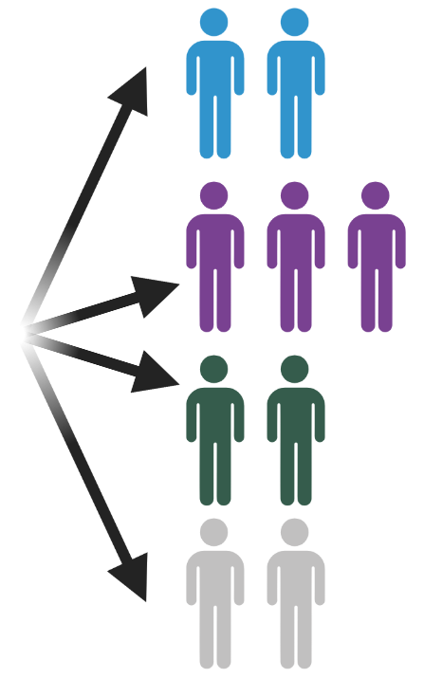
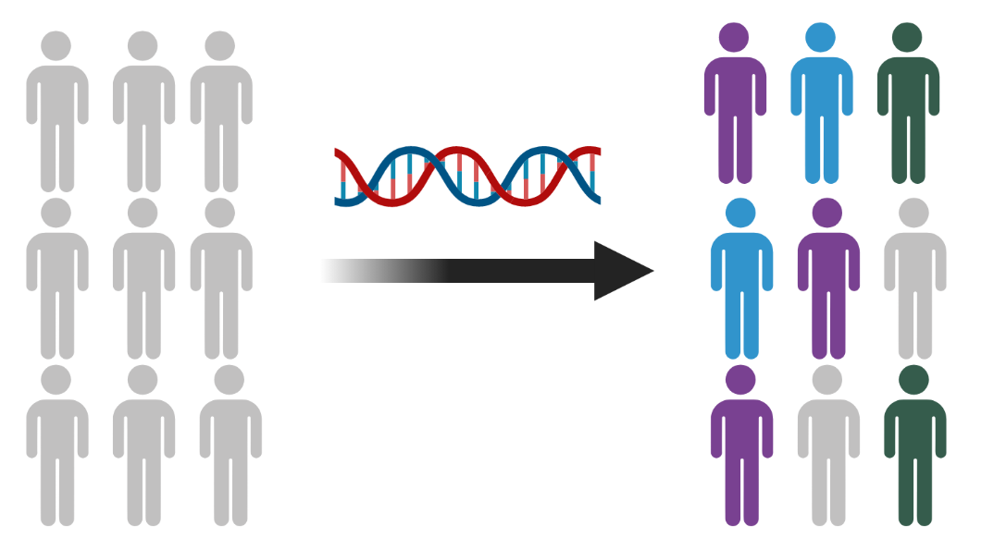
From symptomatic treatment to precision medicine
Adapting the treatment
Biomarkers
Drug repurposing
Development of innovative
therapy
Non pharmacological
treatment
Use of symptomatic treatment
(trial-and-error design)
Detection of rare and common variants

Slide 3
Cohorts : French Minds
Retrospective cohort (FACE)
DNA already available
9 µg sent out for genetic analysis
1 561 with bipolar disorder
870 with schizophrenia spectrum disorder
242 with major depressive disorder
255 with autism spectrum disorder
~ 240 healthy controls
Prospective cohort
Ethical approval
Additional set of 3 000 individuals
Recruitement during the next 5 years
Diagnosis | N
First episode of psychosis | 400
Schizophrenia | 600
Bipolar disorder | 750
Recurrent depressive episodes | 400
Autism without intellectual disability | 350
Controls | 500
Total | 3000

Slide 4
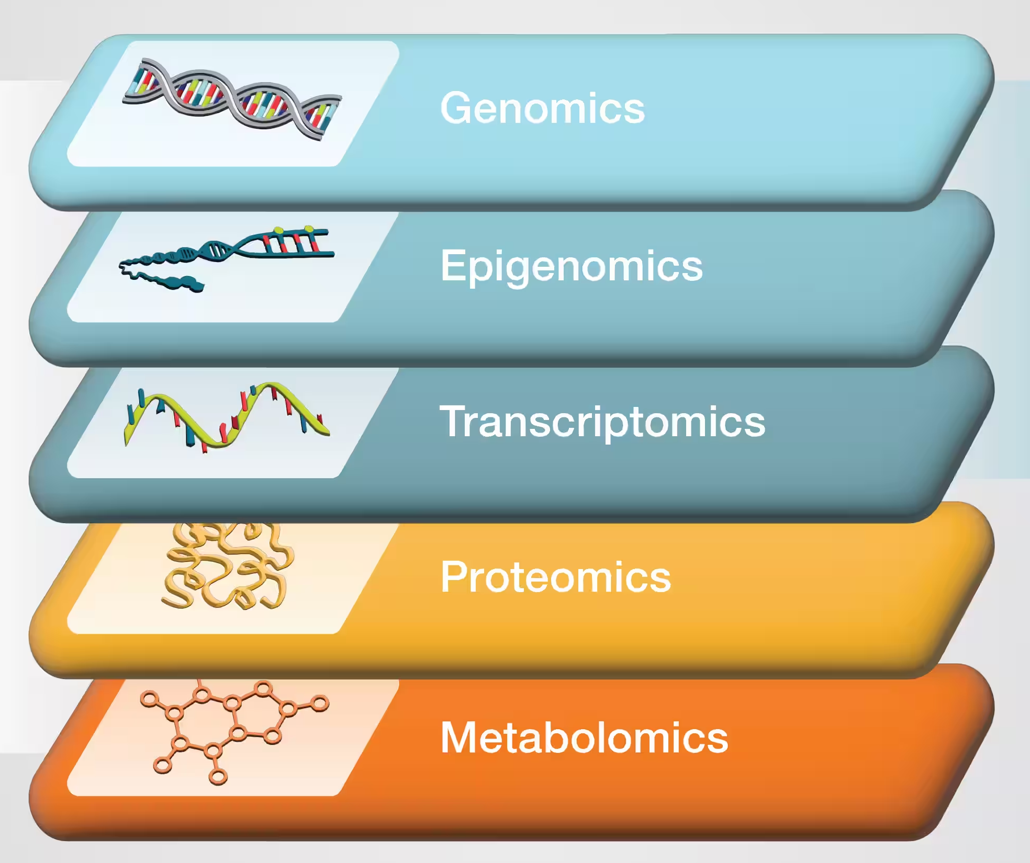
French Minds:
An opportunity to assess the biology at several omic levels
Genotyping (GSA MD) Whole-Genome Sequencing
DNA methylation (EPIC chip)
RNAseq
Olink / NULISA
Mass spectroscopy

Slide 5
Working group « blood biomarkers »
Coordination
Boris Chaumette
Jean-François Deleuze
Romain Rey
Support
Jing Bai
jing.bai@fondation-fondamental.org
Sub-group « statistical genetics »
(GWAS, mendelian randomization…)
Sub-group « genomics » (WGS)
Sub-group « transcriptomics »
(RNAseq, miRNA)
Sub-group « methylomics »
Sub-group « metabolomics lipidomics and proteomics »
Sub-group « pharmacogenetics
and pharmacological therapeutic monitoring »

Slide 6
International collaborations
Country | Collaborator | Task
Netherlands | Wouter Peyrot, Brenda Penninx | GWAS, WGS
UK (Cardiff) | James Walters | GWAS, WGS
Denmark | Katherine Musliner, Bjarni Vilhjálmsson | GWAS
USA | Stephen Glatt | RNAseq, GWAS
Germany | Eva Schulte, Thomas Schultz | Metabolomics
Austria | Vincent Millischer | Pharmacogenetics
Norway | Stéphanie Le Hellard | DNA methylation
UK (London) | Luis Alameida | DNA methylation
Collaboration with the Psychiatric Genomic Consortium, SCHEMA and BIPEX
Proteomics (Florian Raabe, Golam Khandaker), pharmaco-genetics (in prep)

Slide 7
Objective for the next two years
Share genotyping data with the various subgroups of the Psychiatric Genomics Consortium
Calculate polygenic scores for various psychiatric disorders (e.g., schizophrenia, bipolar disorder, depression, autism, etc.) as well as for non-psychiatric conditions (e.g., obesity, diabetes, etc.) and correlate them with clinical symptoms
Determine epigenetic signatures of environmental exposure (cannabis, trauma, infection, etc.) and correlate them with clinical symptoms (methylation scores)
Identify pathogenic genetic variants and determine the percentage of rare diseases based on different clinical presentations (e.g., catatonia, treatment resistance, early onset, etc.)
Identify nucleotide expansions (STR, VNTR, etc.) in the cohort
Identify mitochondrial polymorphisms and correlate them with metabolic function
Develop a pipeline for extracting pharmacogenes from high-throughput sequencing data
Associate pharmacogenetic variants with plasma levels of antidepressants and antipsychotics
Test the BrainGENIE+ model developed by Stephen Glatt on transcriptomic data

Slide 8
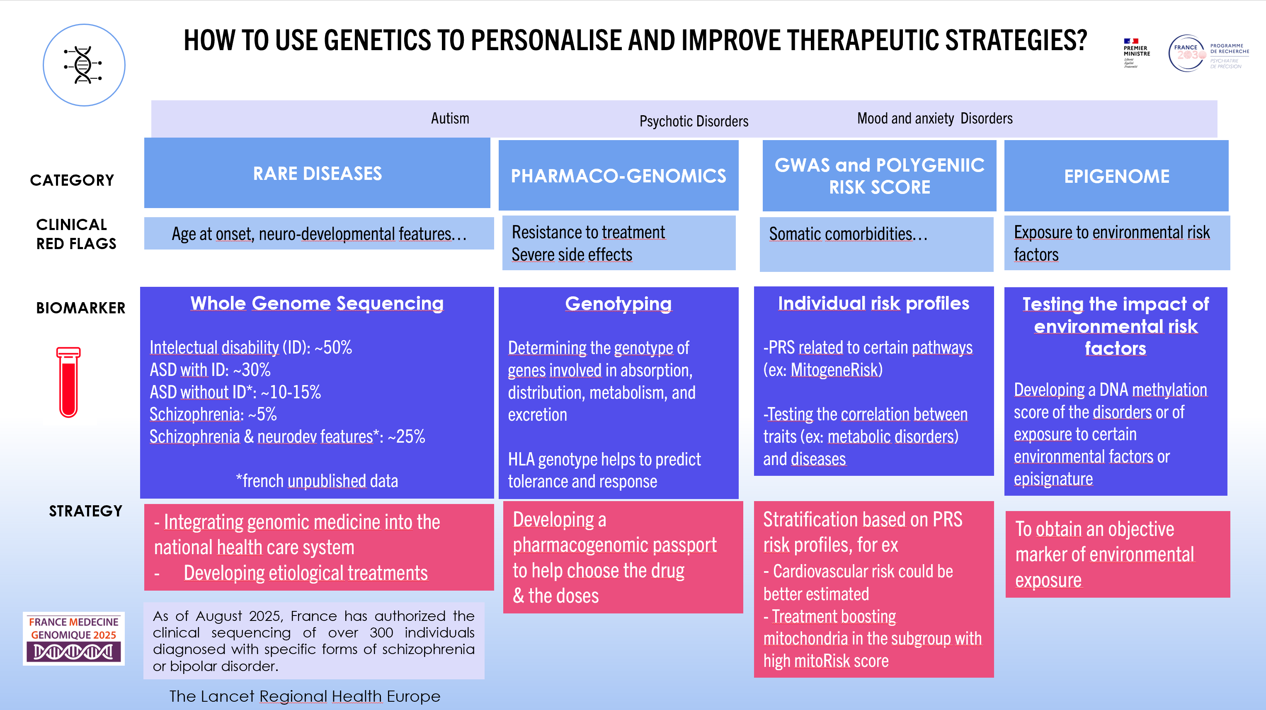

Slide 9
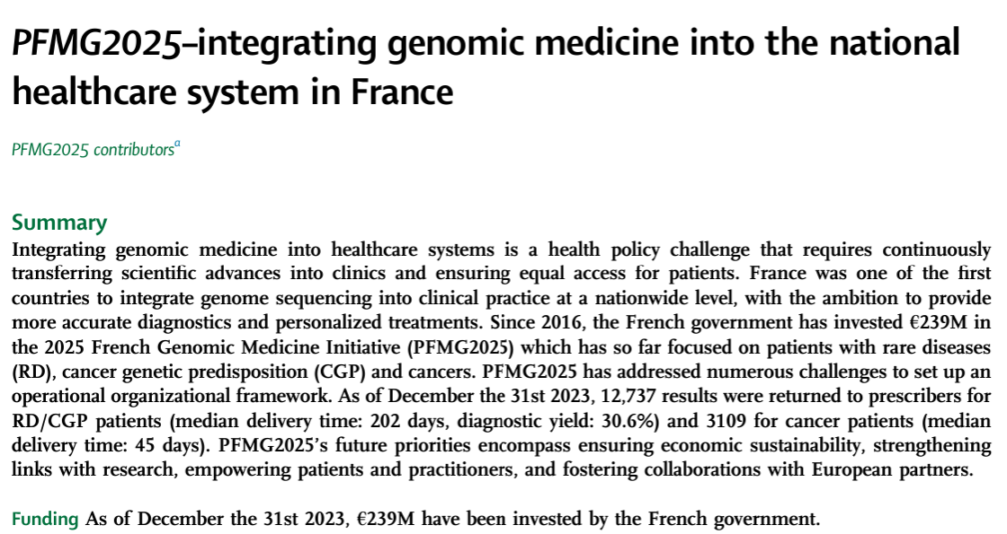


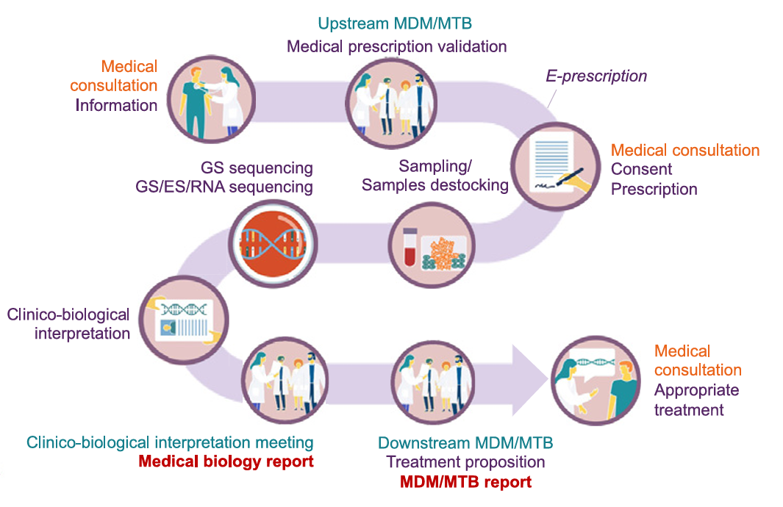
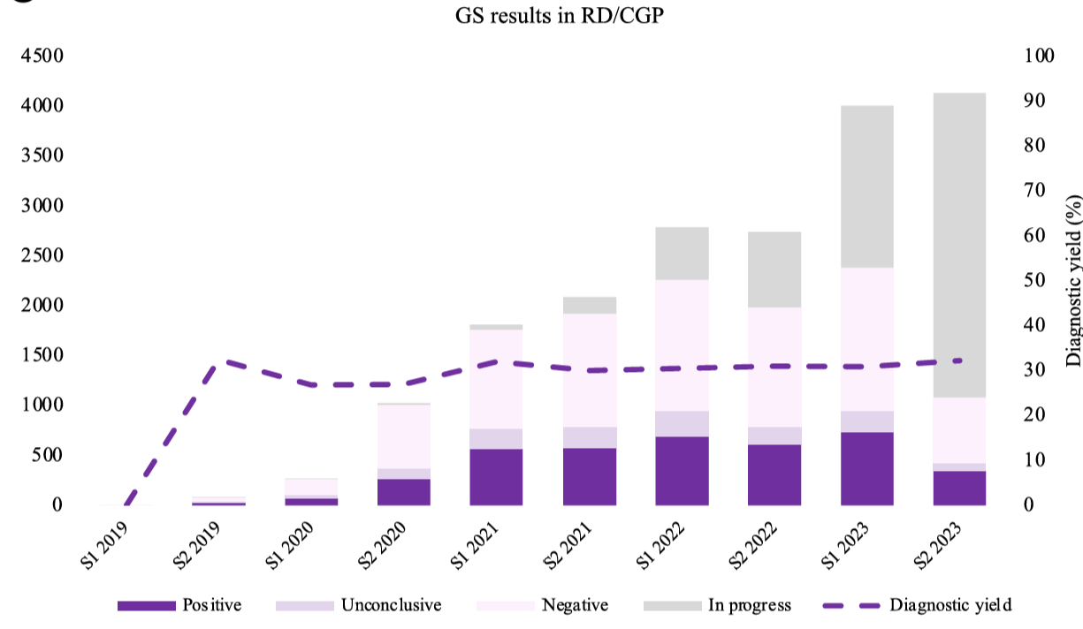
Data from January 2025

Slide 10

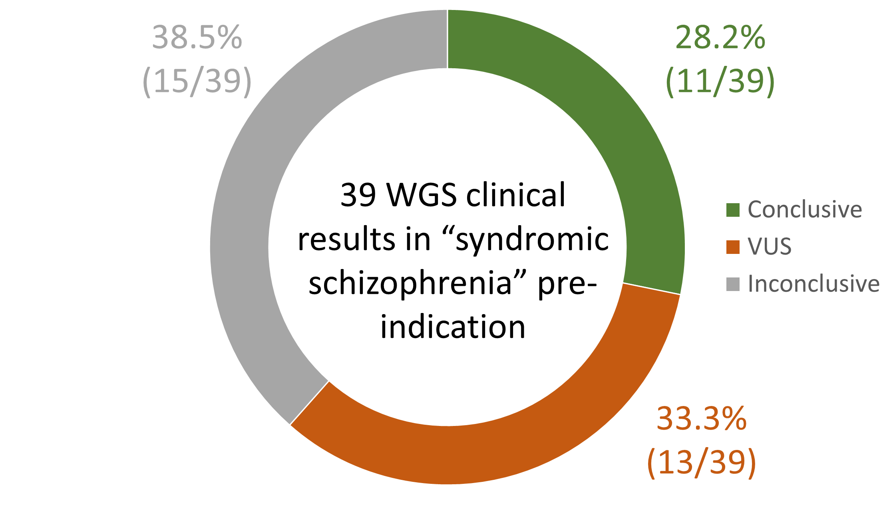
From ‘syndromic schizophrenia’…
At least 1 psychiatric red flags:
onset before age 13
treatment resistance
early and significant adverse effects of treatments
predominant visual hallucinations
At least 1 non-psychiatric red flags:
neurodevelopmental or neurodegenerative disorders
specialized school
abnormal movements unrelated to treatment, degenerative Parkinson's syndrome
epilepsy difficult to balance
dysmorphia
family history suggestive of Mendelian transmission
Thanks to the high molecular yield for syndromic schizophrenia, we convinced the french authorities to extend the criteria to access to whole-genome sequencing in clinical practice

Slide 11
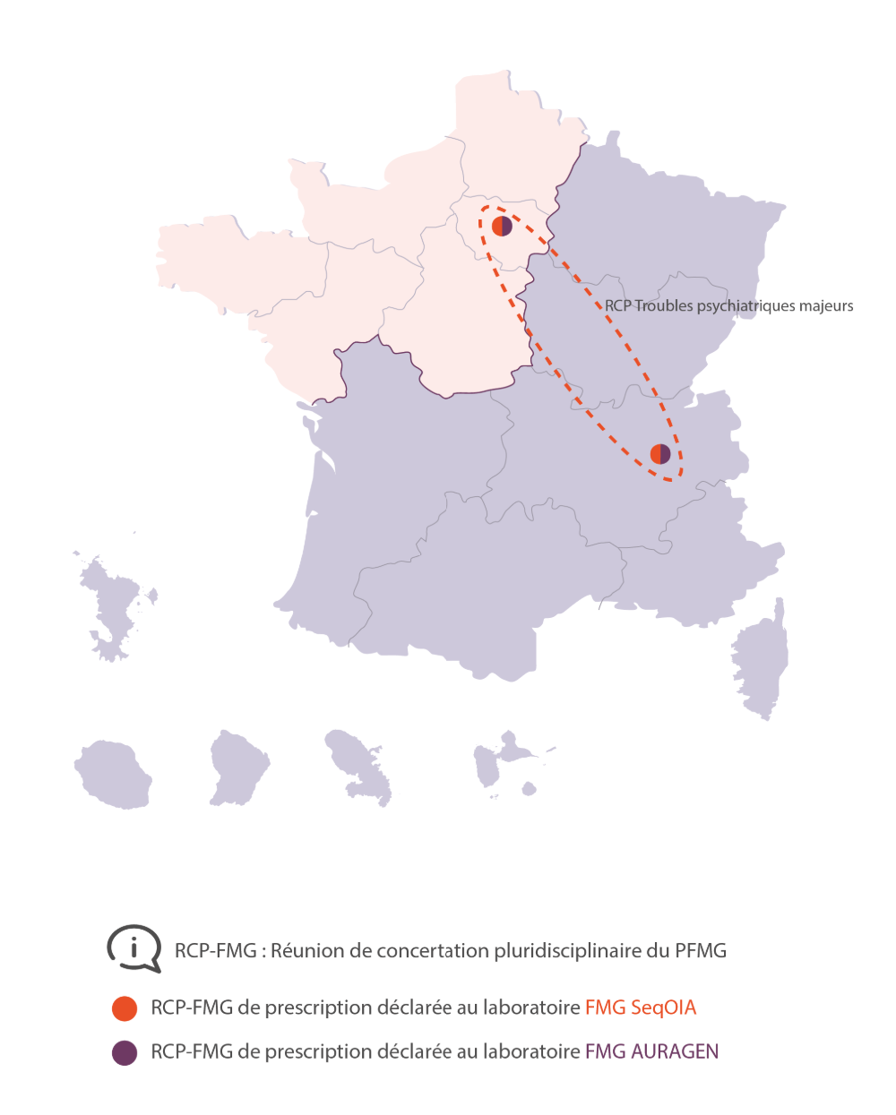
…to ‘major psychiatric disorders: broadening the criteria
Schizophrenia or bipolar disorder
with at least one of the following features
Early age of onset
Resistance to treatment
Early and significant adverse effects of treatment
Associated neurodevelopmental disorder
(e.g. autism spectrum disorder, intellectual development disorder, learning disability, special schooling, etc.)
Cognitive or motor disorders suggesting a neurodegenerative origin
(e.g., decline in executive or memory functions at an early age)
Dysmorphia or organic disease suggesting a genetic origin
(e.g. poorly stabilized epilepsy, associated heart disease, etc.)
Family history of psychiatric disorders or sporadic case
Atypical presentation of the disorder
(e.g. visual hallucinations, confusion, catatonia, etc.)
Molecular yield (n=254)
Class IV or V : 18,7%
VUS : 30%
The number of centers able to prescribe whole genome sequencing has raised since 2023

Slide 12
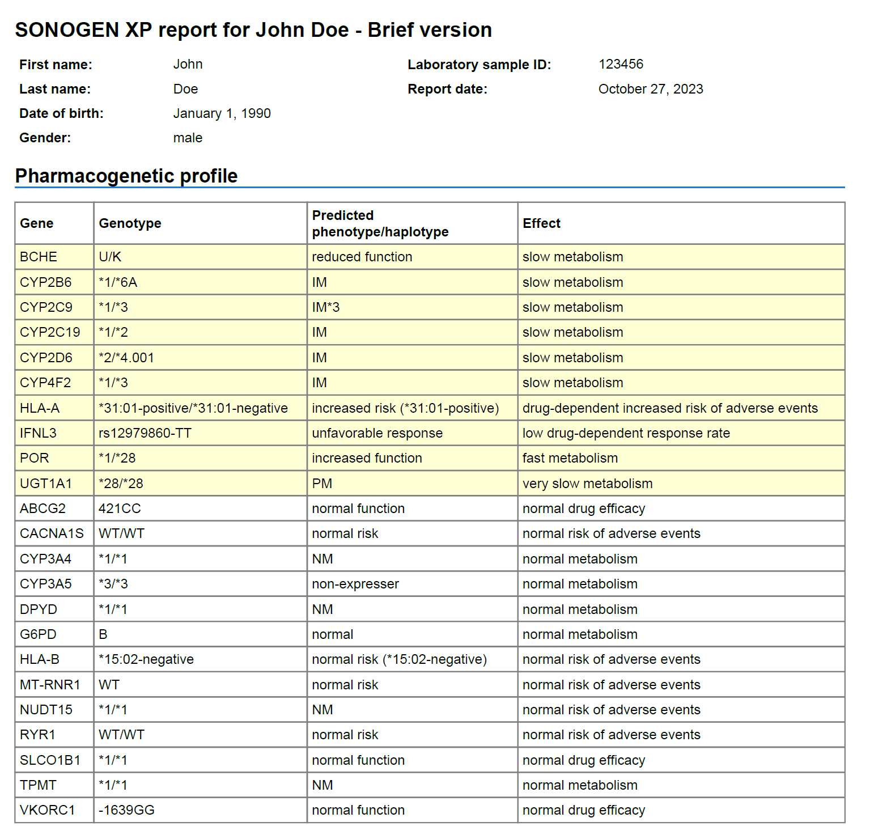

Slide 13
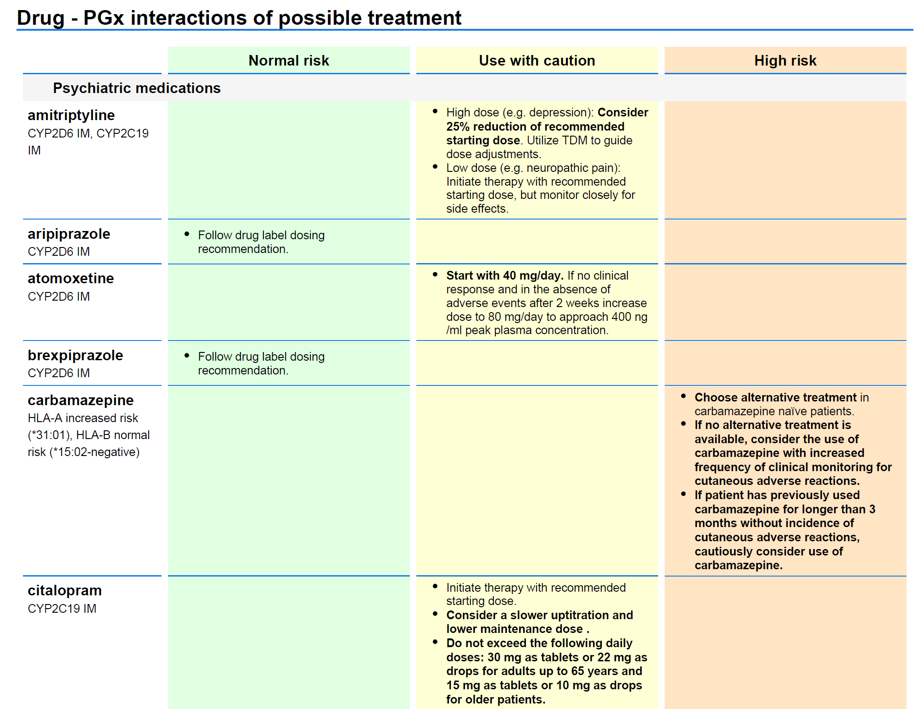

Slide 14


Method | Currently | Methods | Clinical applications
Pharmaco genetics | No daily use No national guideline | Use of cytochromes and HLA genotyping Decision support with a "digital twin" application | Prediction of side-effects Individual recommendation based on pharmaco-genomics Pharmaco-passport
Constitutive Genetics | Detection of rare disorders in several specialized centers No evidence-based guidelines | Large use of genetic testing at the national level Opening the sequencing for other psychiatric illnesses | Validation of clinical criteria to access to whole-genome sequencing Identification of novel variants Understanding the pathophysiology in relation with environmental factors and sub-groups definition

Slide 15




Institutional endpoints
Participation to the Clozapine Taskforce and modifications of the national recommandation
for white blood cells monitoring
Interview for the Plan France Medecine Genomique 2.0
National guidelines for pharmacogenetics (in process)

