Slide 1
ED-PROPSY – Digital Tools for the French Minds Cohort
Pr. Pierre Philip
Sanpsy, CNRS UMR 6033, Université de Bordeaux
Service Universitaire de Médecine du Sommeil, CHU de Bordeaux

Slide 2

Sommaire
Context
Wearables
KANOPSY Application
4. Monitoring tools

Slide 3
Context

Slide 4
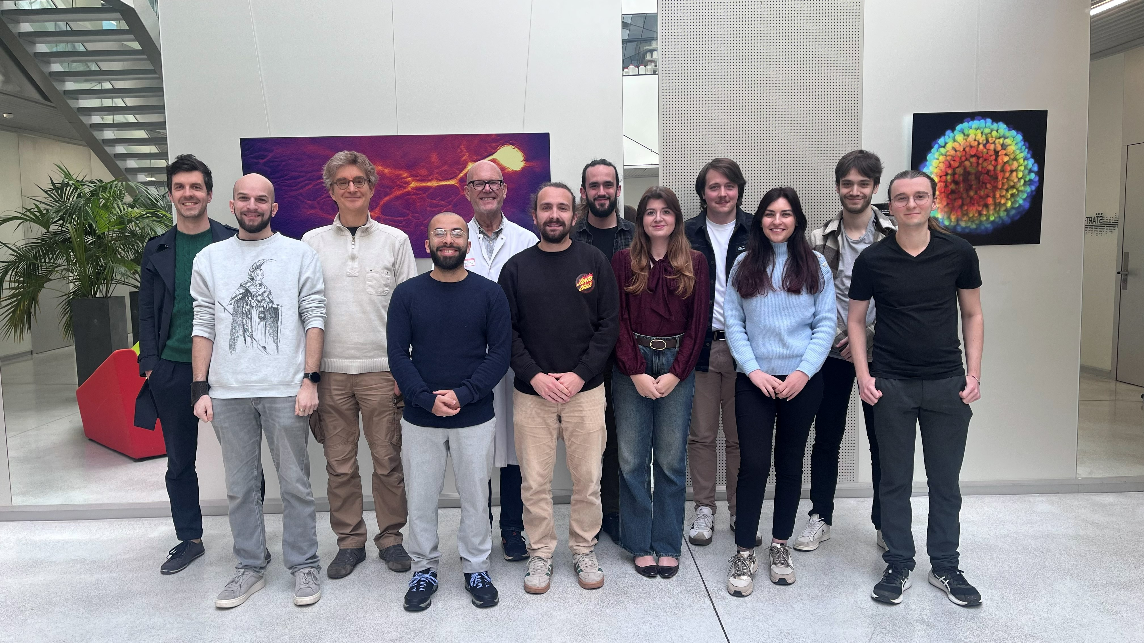
Research Support Unit AI (UAR-IA)

Slide 5

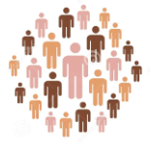
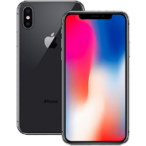

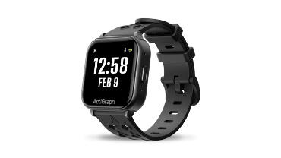


Projects
Intracranial aneurysm
AutonomHealth
Bipolar disorder, Schizophrenia,
Autism, Major depressive disorder
Neurovasc
Cohort follow-up
eD-Propsy
RHU
Audicobe
Intervention

Slide 6
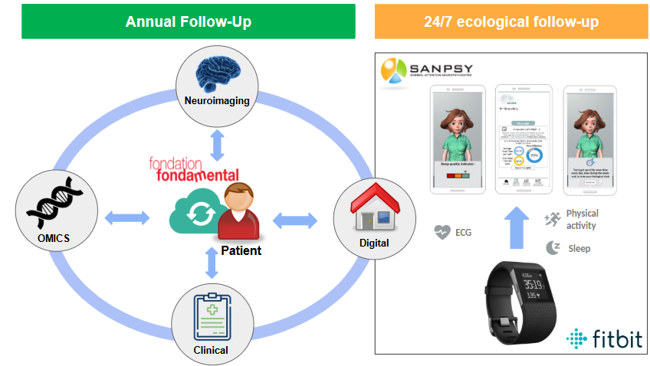
Context
Qurestionnaires
Qurestionnaires

Slide 7
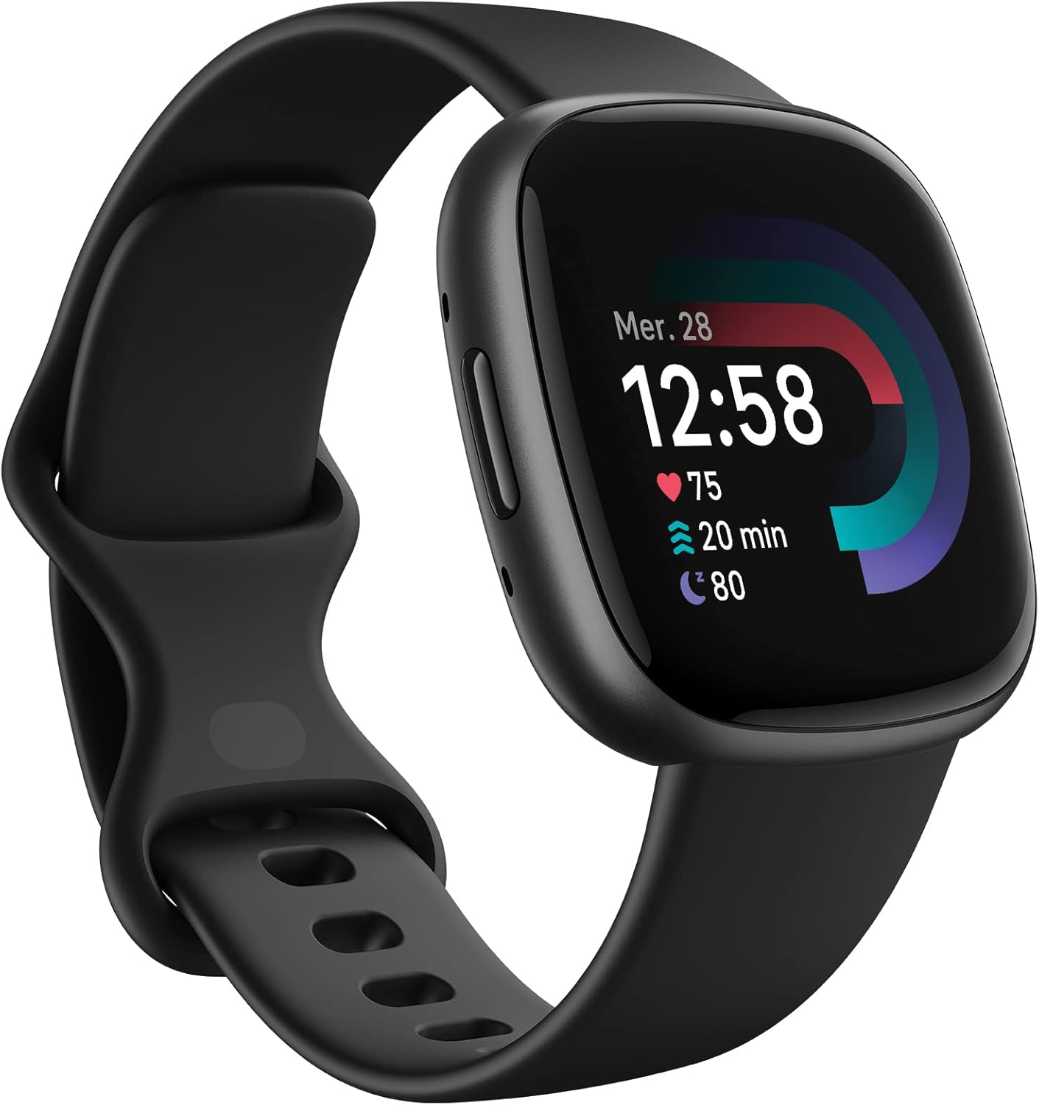
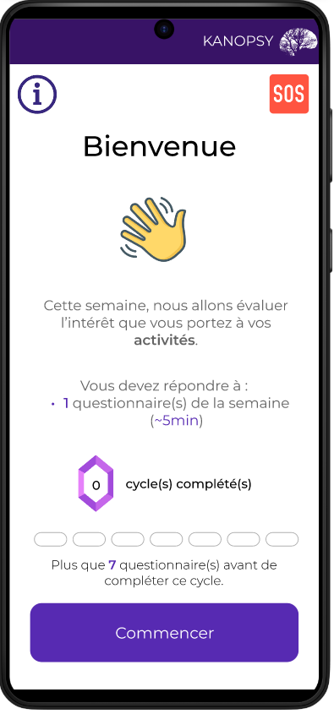
Context
1 year digital follow up
Wear smartwatch at least 14 days / season
Send back both phone and smartwatch at the end
Jul
Jan
Aug
Sep
Oct
Jan
Jan
Nov
Dec
Jan
Feb
Mar
Apr
Jan
May
Jun
Notifications:
Answer Questionnaires
Wear smartwatch

Slide 8
2. Wearables

Slide 9
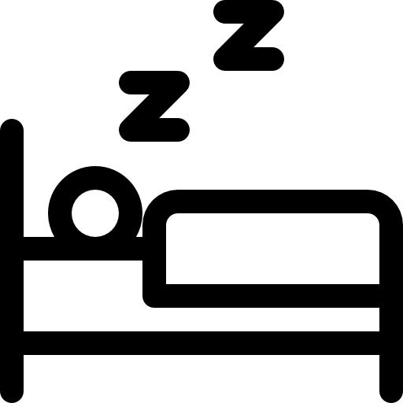


Wearables - Overview
Number of publications / domain
Brand | Overall | Sleep | Physical Activity | ECG
ActiGraph | 4,516 | 1,478 | 2,963 | 183
FitBit | 2,171 | 606 | 1,163 | 358
OURA | 1,873 | 164 | 58 | 78
HUAWEI | 729 | 26 | 21 | 23
Garmin | 712 | 69 | 174 | 141
MotionWatch | 572 | 484 | 114 | 16
AppleWatch | 532 | 68 | 107 | 188

Slide 10
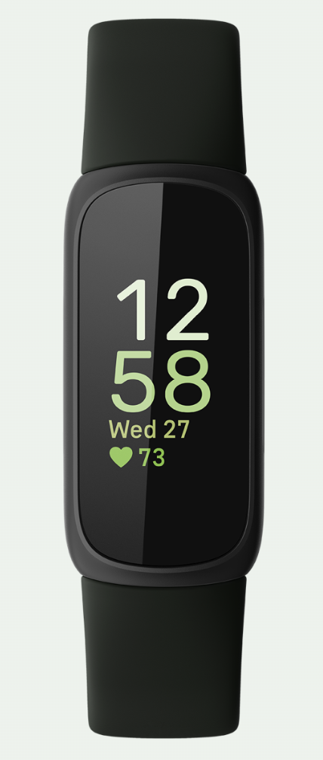

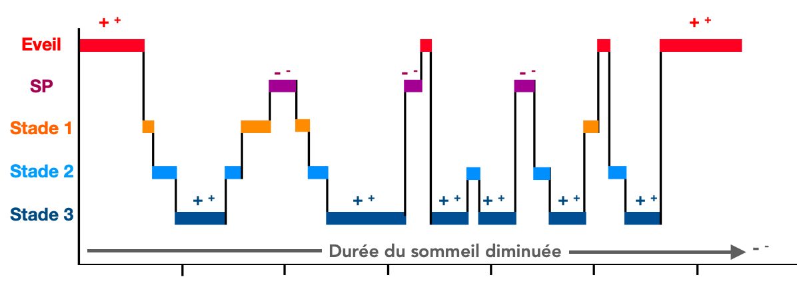
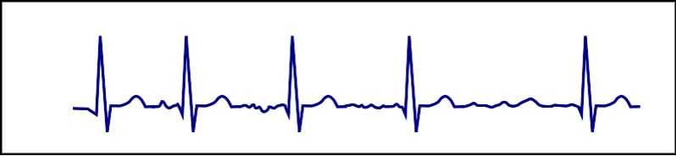
Wearables - Fitbit
~5M units sold per year
FitBit®
Price
Battery
Storage
Storage
Connectivity
5 days
100$
5 days
ECG
Sleep stages

Slide 11
3. KANOPSY Application

Slide 12
Kanopsy – Home Page
Information / Tutorials
Emergency case
Questionnaires

Slide 13
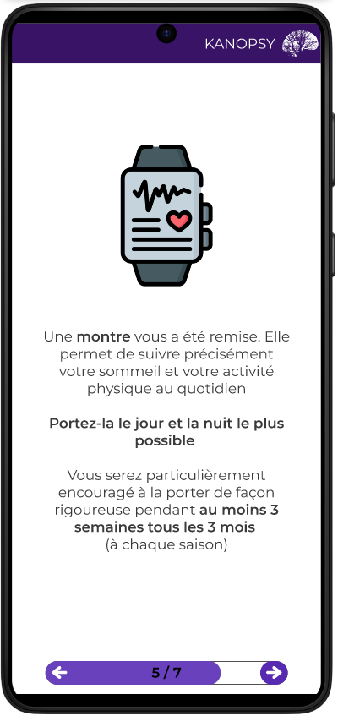
Kanopsy – Information
Explains the purpose of the application
  Wearable to wear at least 2 weeks / season
  Questionnaires every weeks
  Reminders
Describe the application
  7 questionnaires
  1 or 2 questionnaires/week
  Cycles back every 4 weeks

Slide 14
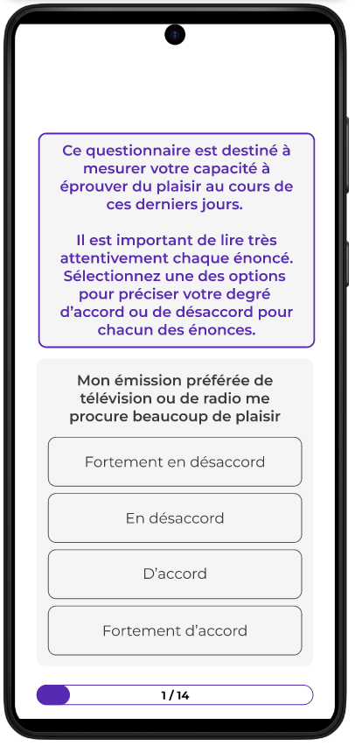
Kanopsy – Questionnaires
Day 1
Day 7
Day 14
Day 21
Anhedonia
SHAPS
14 items
Insomnia
ISI
7 items
Loneliness
Loneliness
11 items
Anxiety
GAD-7
7 items
Sleepiness
ESS/HSI
8-9 items
Pain
PPP-VAS
9 items
Depression
PHQ-9
9 items

Slide 15
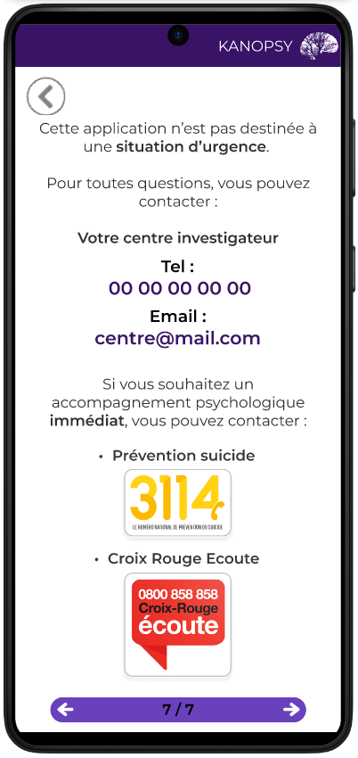
Kanopsy – Emergency Case
Contact Expert Centers
Contact Hotlines

Slide 16
4. Monitoring tools

Slide 17
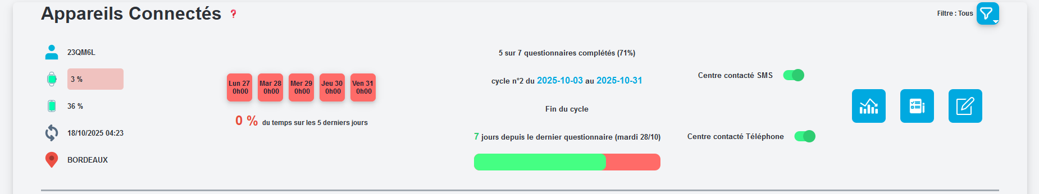
Monitoring Tools - Overview
Fitbit status over 5 days :
Fitbit worn > 12h ➔
Fitbit worn between 0 and 12h ➔
Fitbit not worn ➔
Details :
Fitbit
Questionnaires
Notes
Main information :
Patient ID
Fitbit battery level
Phone battery level
Latest synchro fitbit / phone
Expert Center
KANOPSY Questionnaires:
Number of questionnaire done,
Current cycle w/ corresponding dates
Number of days before next cycle
Number of days since last questionnaire

Slide 18
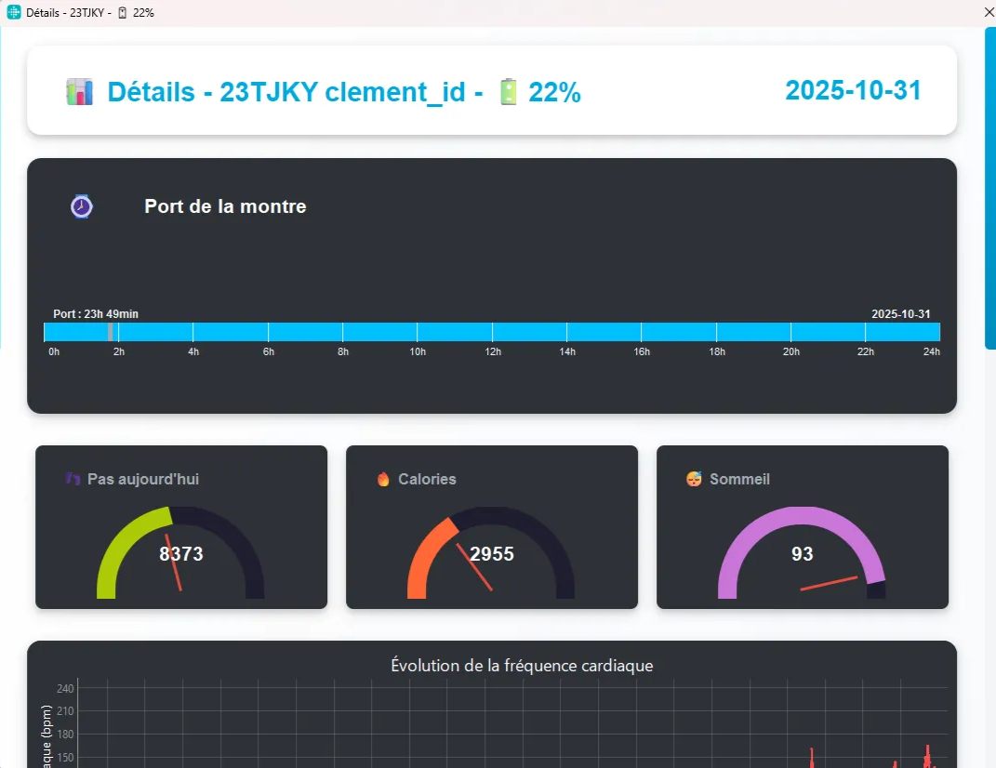
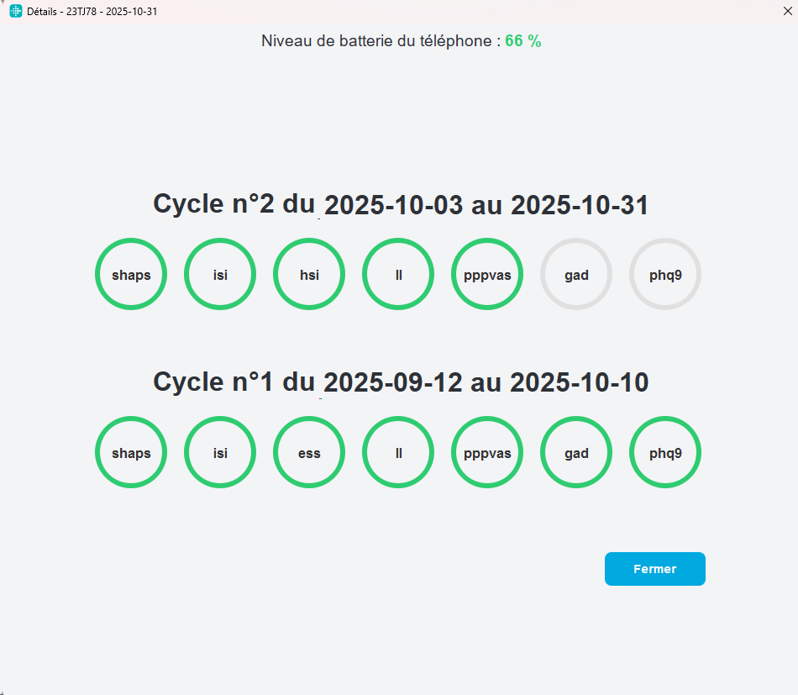
Monitoring Tools - Details
Fitbit details
Questionnaires details

Slide 19
Thank you for your attention !

