Slide 1
Pharmacologie et résistance
Boris Chaumette – Université Paris Cité

Slide 2
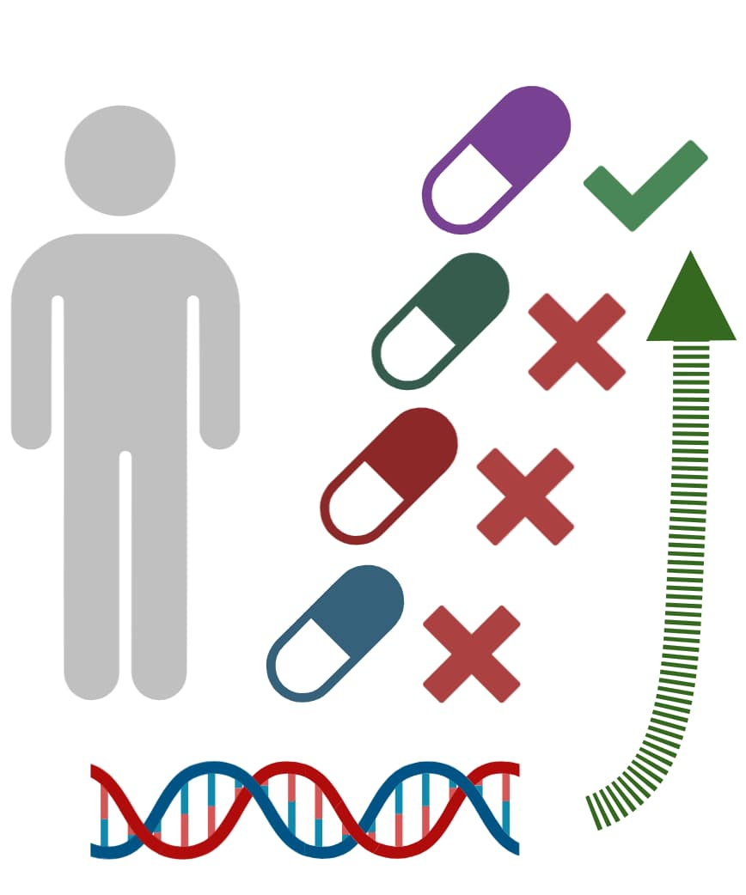



Pseudo-resistance
(pharmacogenetics…)
Resistance is defined by trial and error process
Prescribe the right drug without delay
Develop new drugs targeting novel pathways

Slide 3
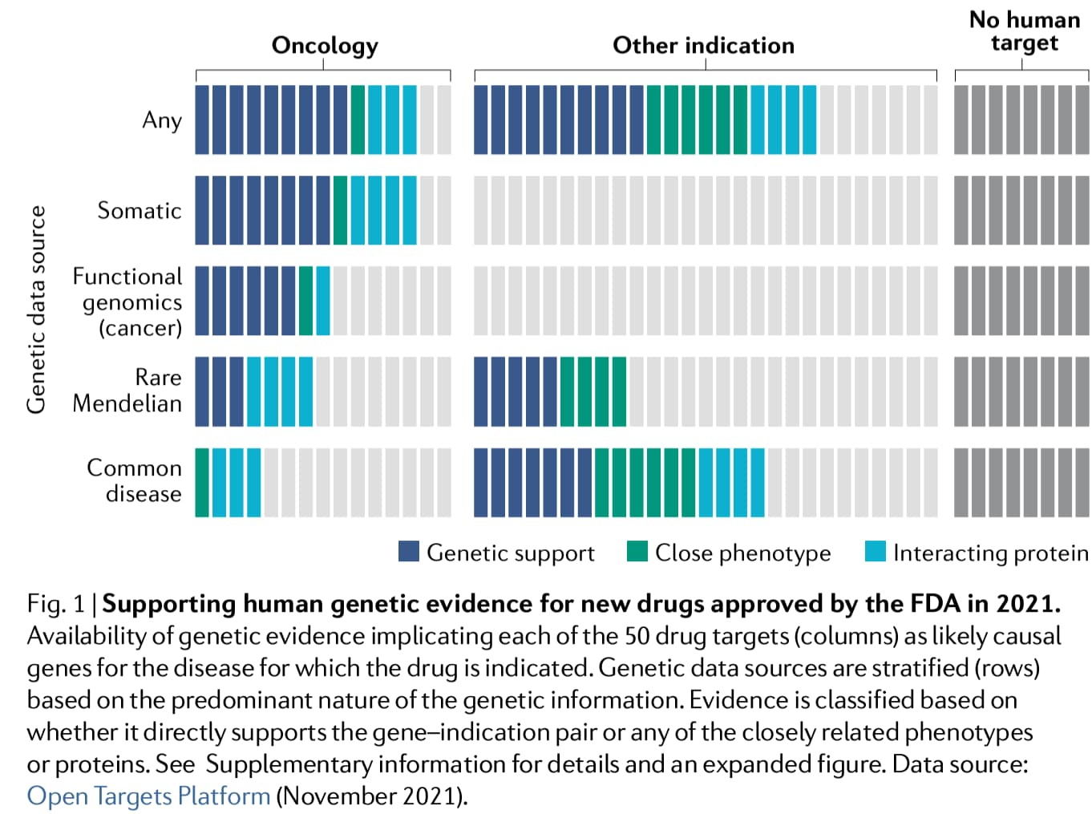
The translational value of genetics
Nelson et al 2015
Nature Genetics
Human genetics evidence supports two-thirds of the 2021 FDA-approved drugs
Ochoa D et al – 2022 Nature Reviews Drug Discovery

Slide 4
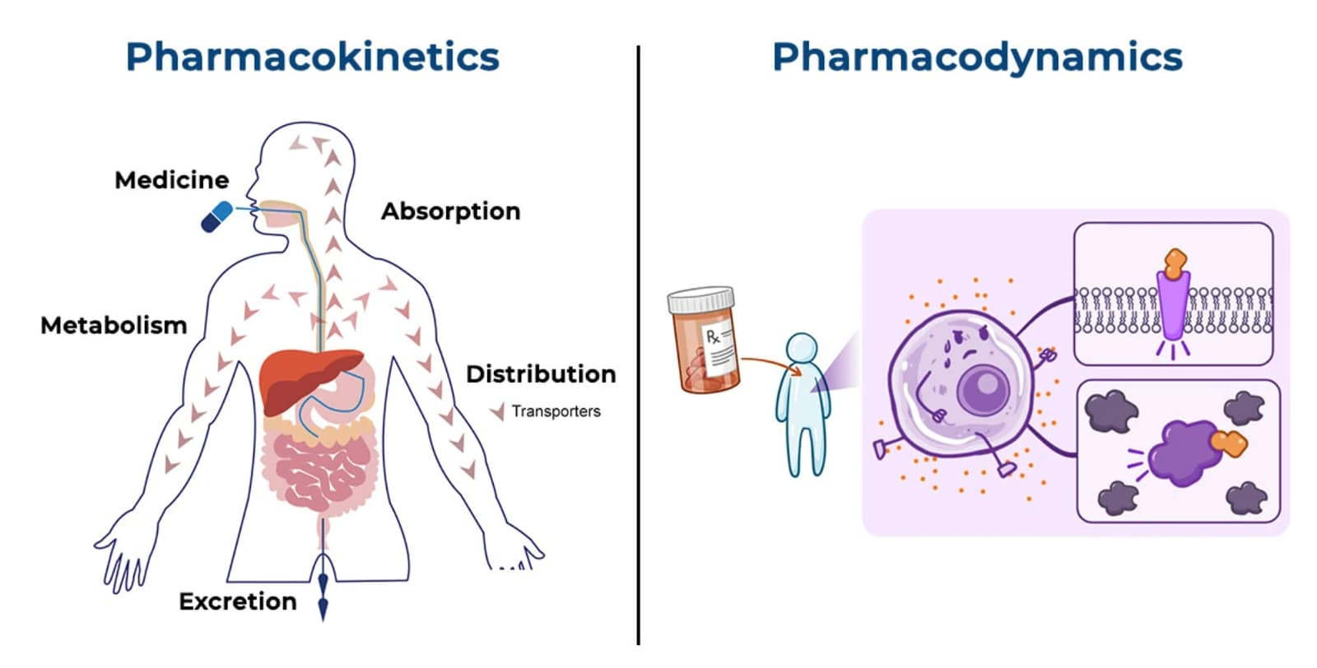

Slide 5
Pharmacocinétique

Slide 6
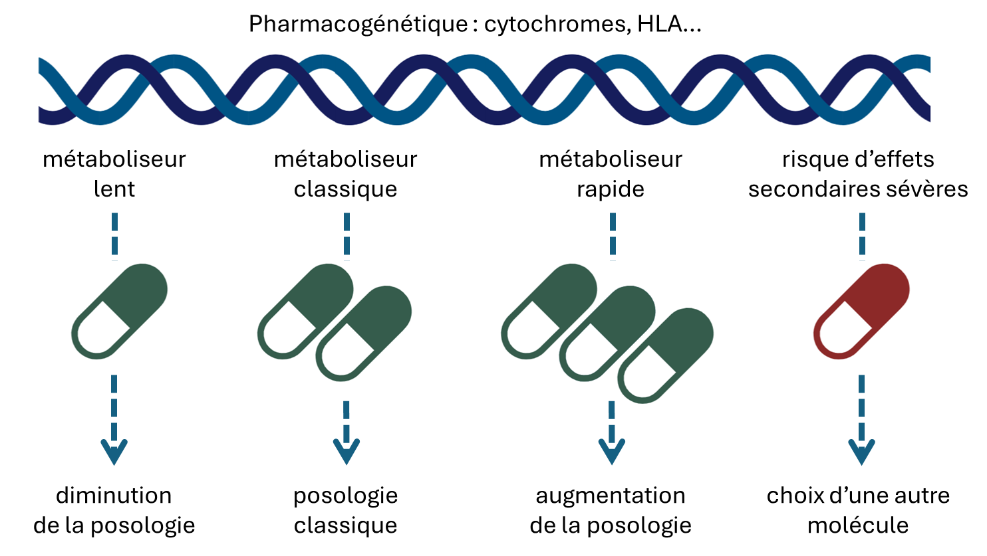

Slide 7
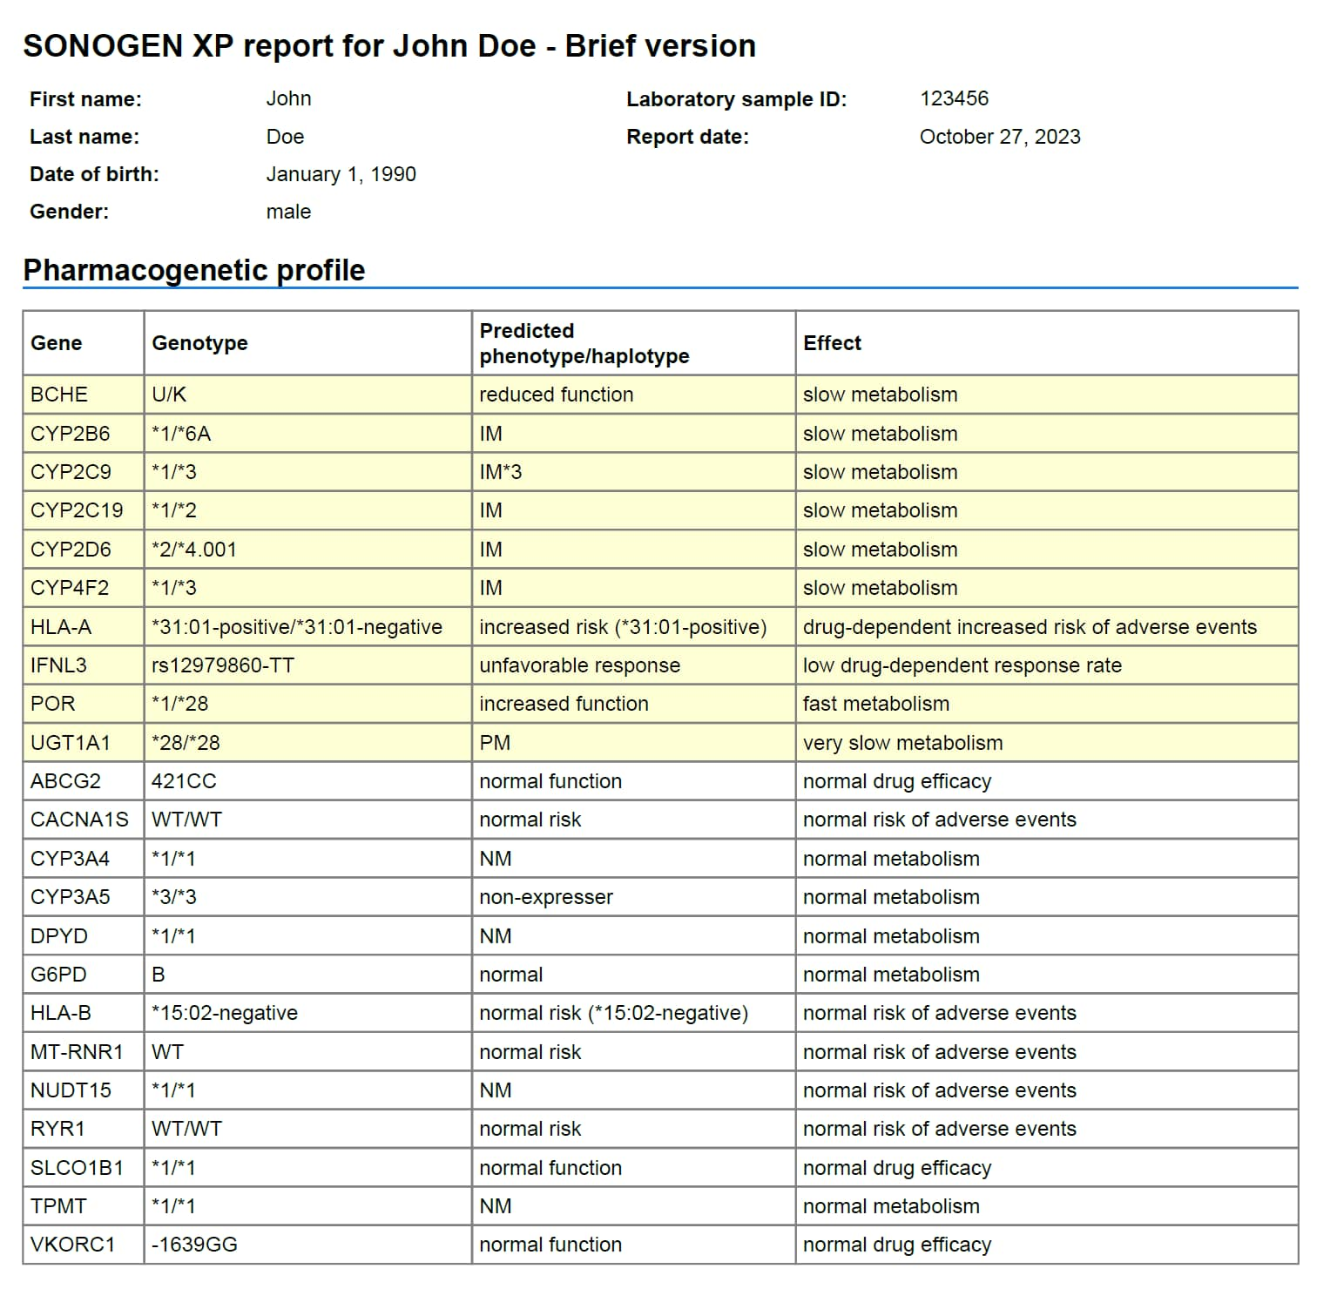

Slide 8
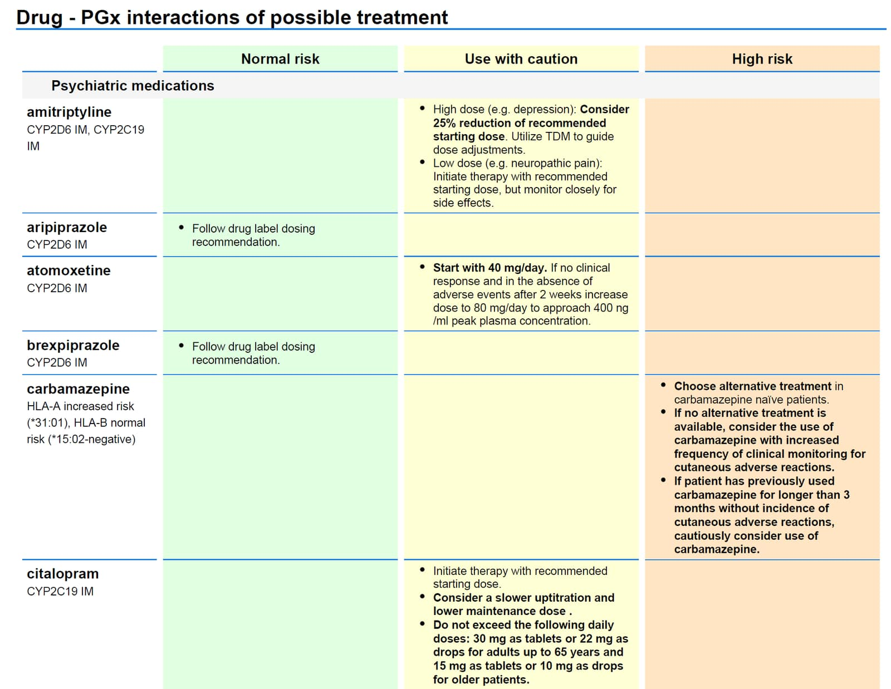

Slide 9
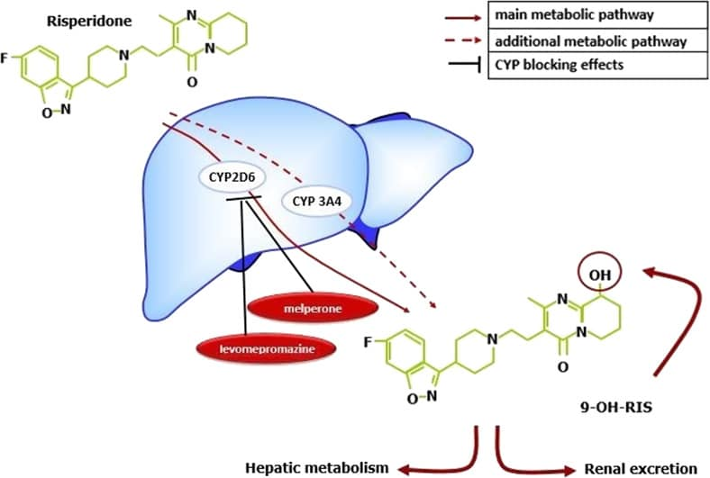
Pharmacocinétique
Interaction avec d’autres molécules et avec l’alimentation, le tabac…
Variabilité individuelle du fait de polymorphismes génétiques, du fonction des reins, du foie, de l’âge, du sexe…
Intérêt du dosage des taux plasmatiques

Slide 10
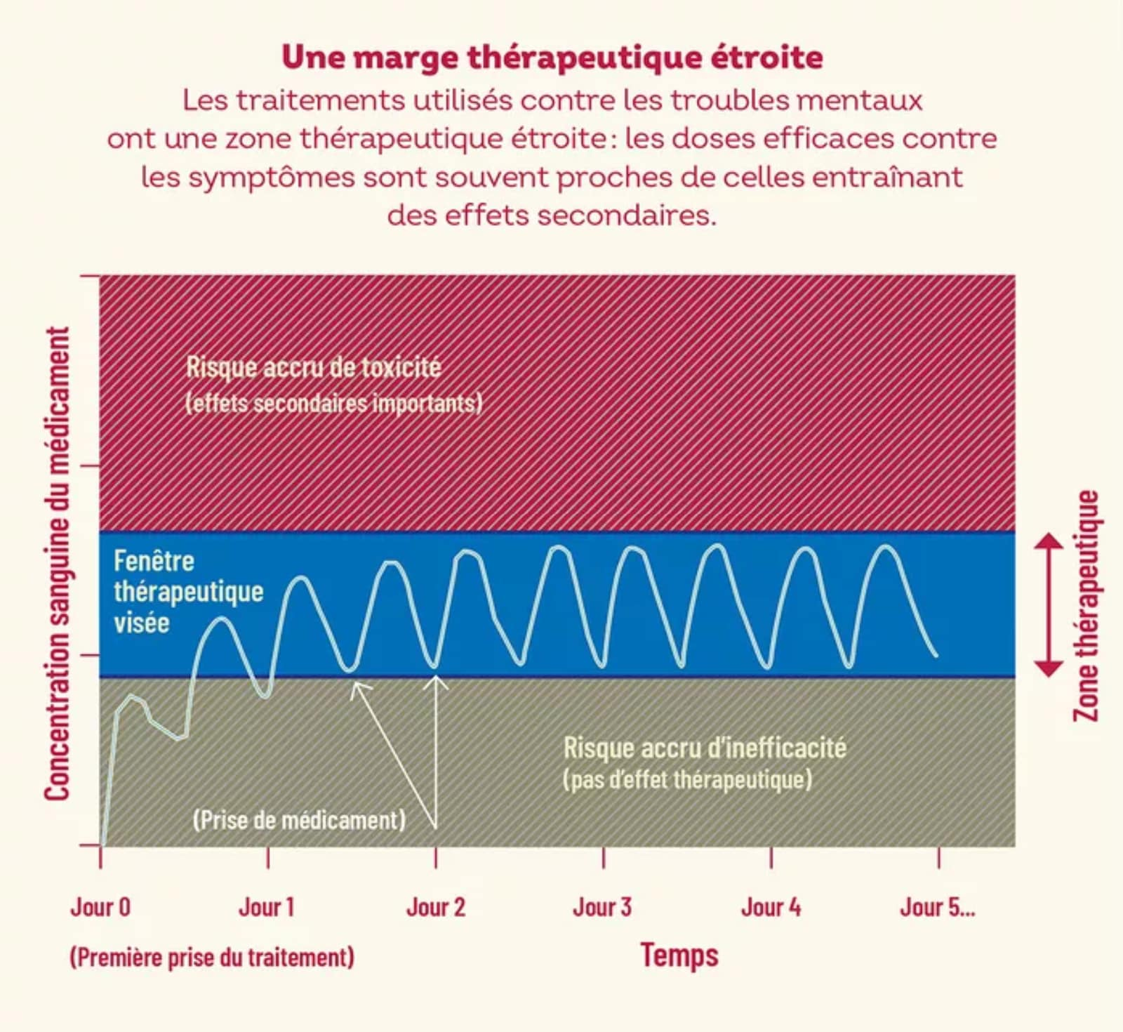

Schéma emprunté à Xavier Declèves

Slide 11
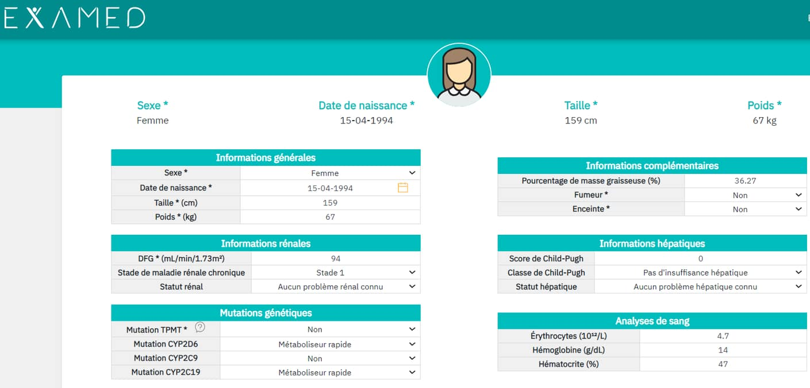


Slide 12
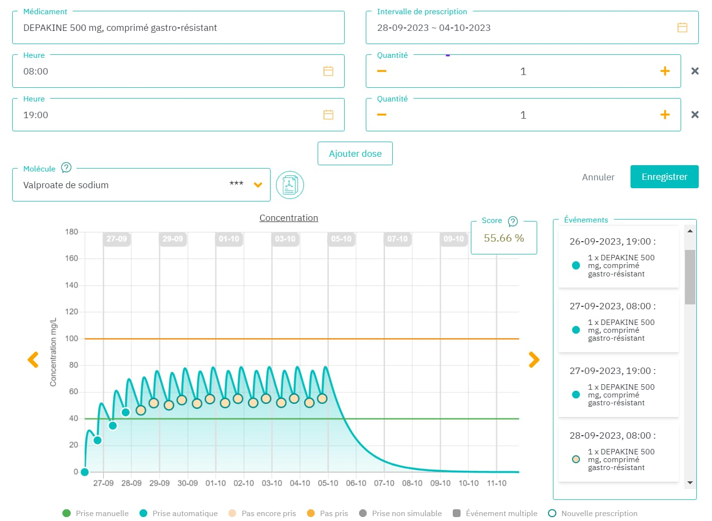

Slide 13
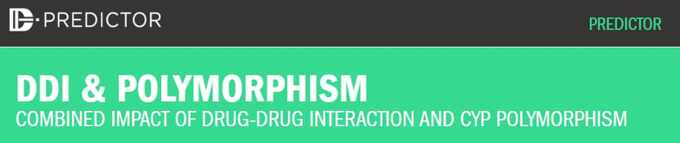
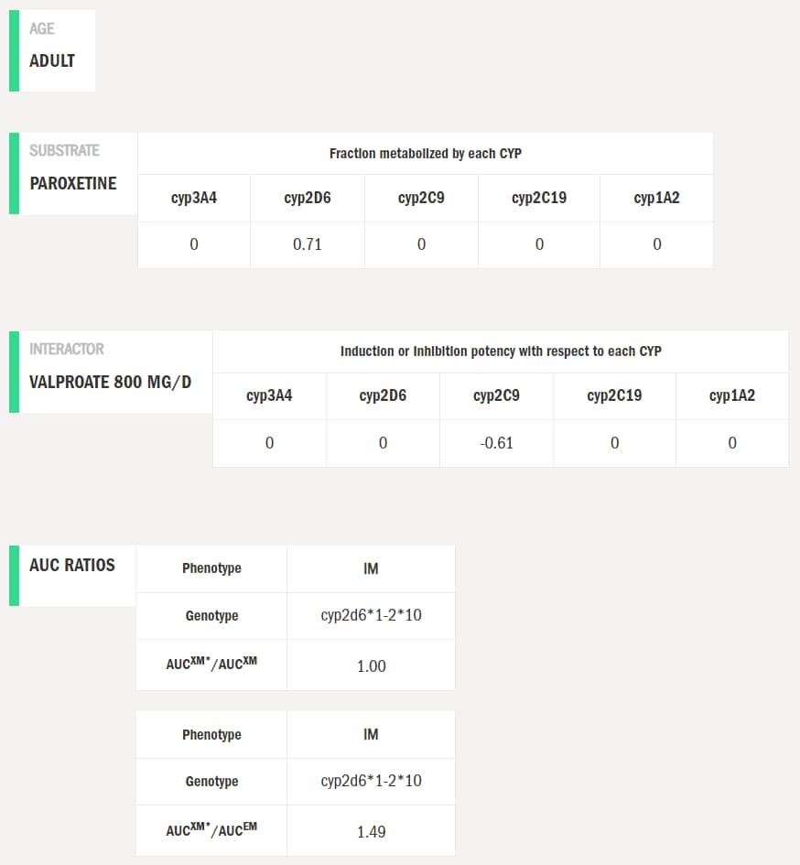

Slide 14
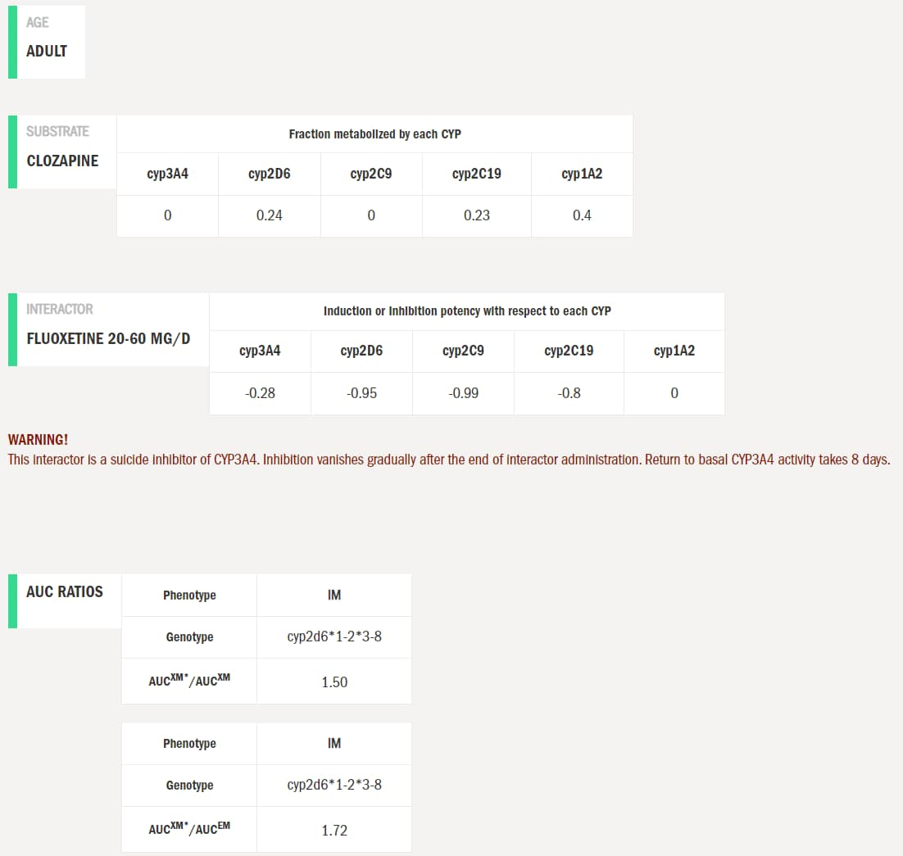

Slide 15


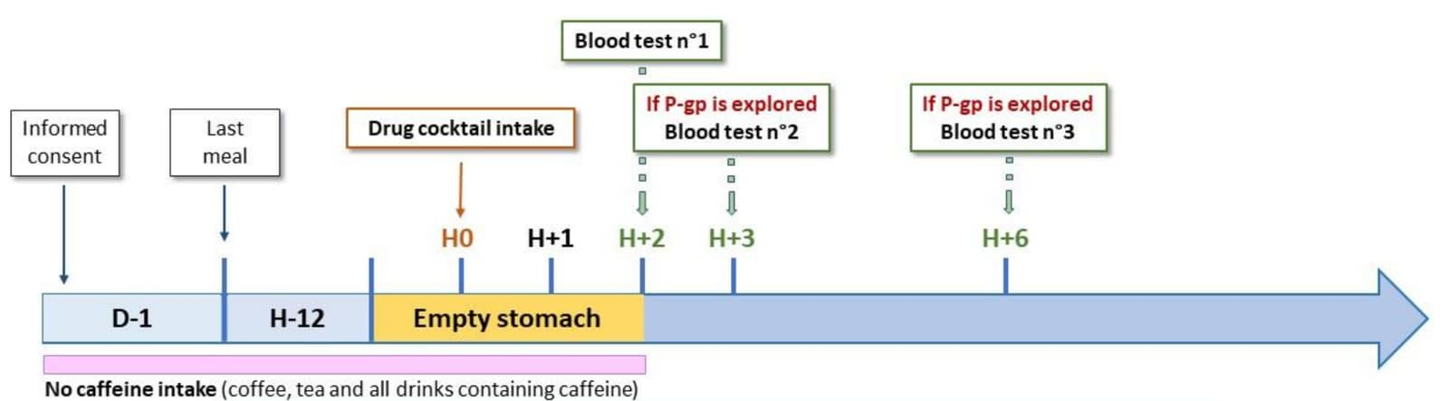
Développement
d’un algorithme
Mise en place du phénotypage des cytochromes (cocktail de Genève)

Slide 18
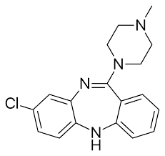
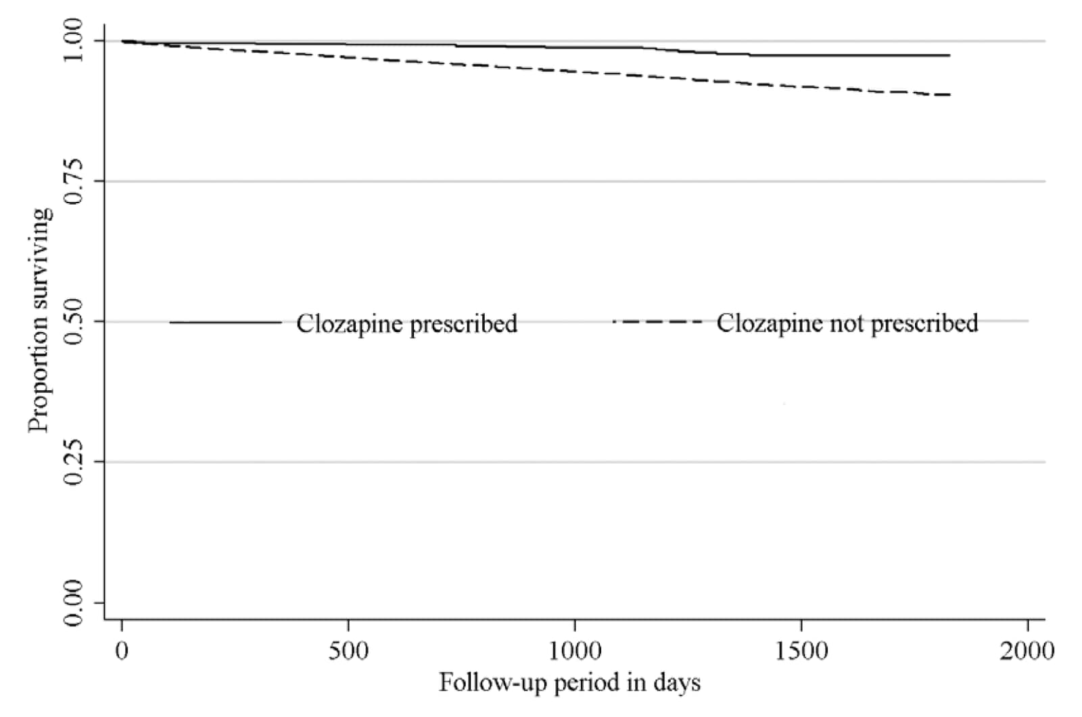
La clozapine est une molécule améliorant la réponse thérapeutique et ayant peu d’effets secondaires moteurs.
Elle est réservée aux formes résistantes de schizophrénie/troubles bipolaires.
Si toute la cohorte avait reçu de la clozapine, 583 décès auraient potentiellement pu être évités.
Hayes et al 2014. Schiz Bull
Utilisation de la base du South London and
Maudsley NHS Foundation Trust
14 754 individus suivis pendant 5 ans
879 décès
6,2% si absence de clozapine
2% avec clozapine
Hazard ratio ajusté : 0,4 (IC95%: 0.2–0.7; p = .001).

Slide 19



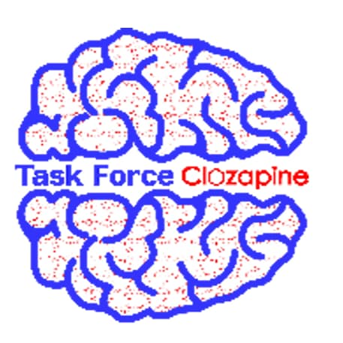
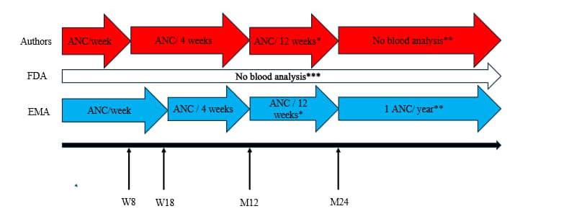

Depuis 2019, sur 1768 dossiers disponibles dans l’entrepôt de données :
Agranulocytose = 5 patients (0,28%)
Mortalité = 0
Sandroni et al (submitted)

Slide 20
Positionner la pharmacogénétique en amont
HLA-DRB1*04:02 est un prédicteur de l’agranulocytose induite par la clozapine (OR=5.89).
Sensibilité : 26%
Spécificité : 94%
Valeur predictive positive : 3,8%
Valeur predictive negative : 99,3%
Islam F, et al Pharmacogenomics J. 2022

Slide 21
Pharmacodynamie

Slide 22
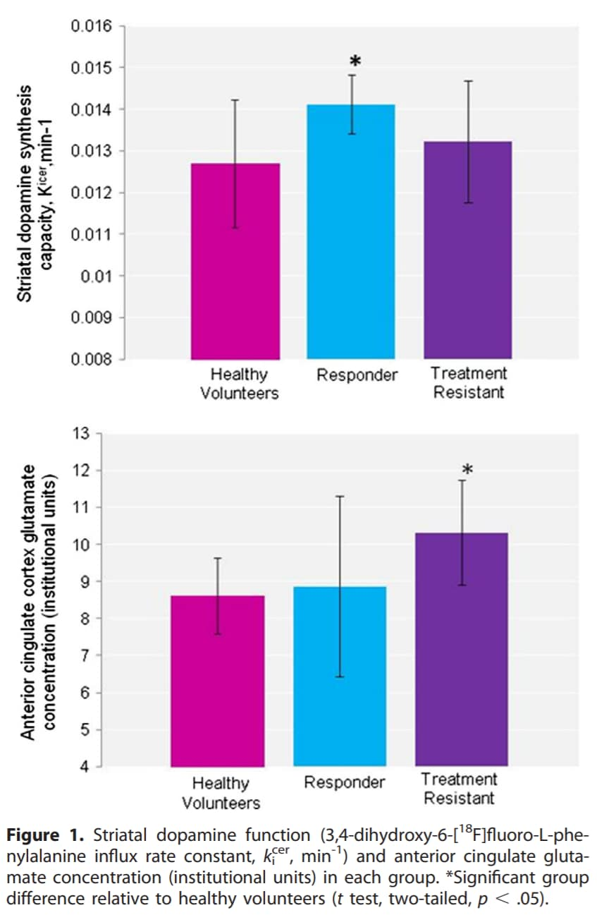
Same clinical trouble,
different pathophysiologies
Resistance or wrong target ?
Murray R et al. Biological Psychiatry 2014

Slide 23



Beyond pharmacogenetics?
57-year-old male
Chronic depression and anxiety
Response to treatment:
No response
Severe side-effects (dystonia, dyskinesia…)

Slide 24
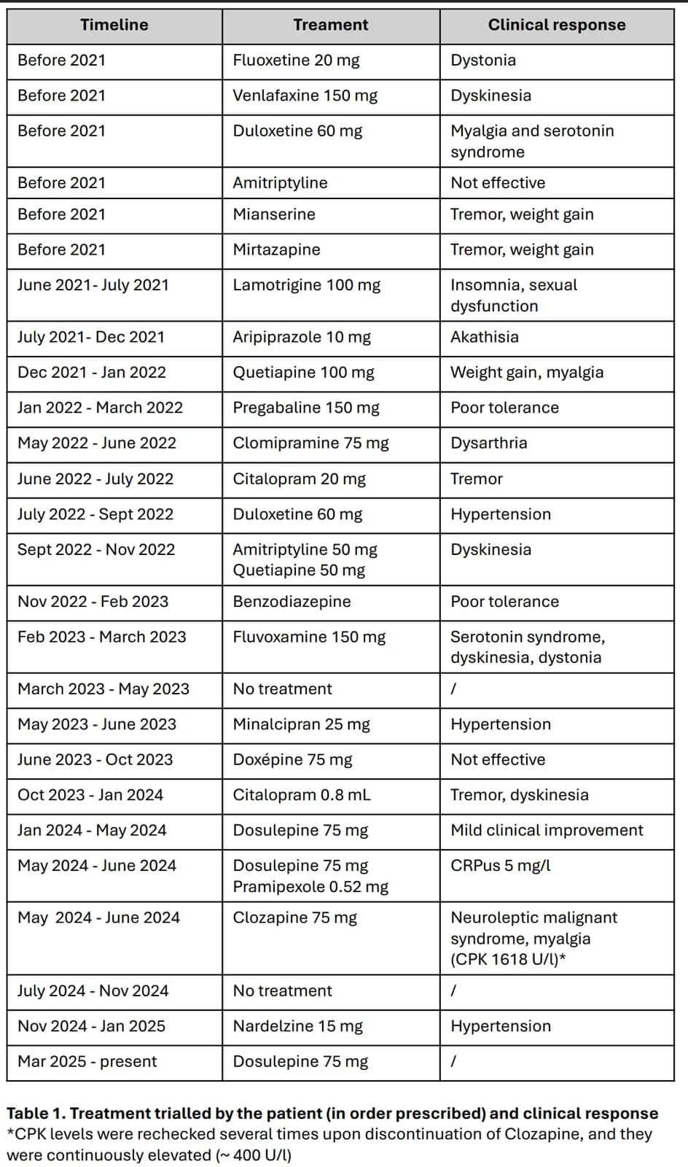
Chimiogramme

Slide 25
Beyond pharmacogenetics?
57-year-old male
Chronic depression and anxiety
Response to treatment:
PGx test – no variant of interest in pharmacogenes
No response
Severe side-effects (dystonia, dyskinesia…)

Slide 26
Beyond pharmacogenetics?
57-year-old male
Chronic depression and anxiety
Response to treatment:
PGx test – no variant of interest in pharmacogenes
Exome test – pathogenic variant in TRPV4
No response
Severe side-effects (dystonia, dyskinesia…)

Slide 27
Beyond pharmacogenetics?
NM_021625.5:c.805C>T present in literature
Associated with various neuromuscular diseases
Link with depression in mice and human

Slide 28
Beyond pharmacogenetics?
NM_021625.5:c.805C>T present in literature
Associated with various neuromuscular diseases
Link with depression in mice and human
Sensitivity to psychotropic molecules?
Explanation for side-effects?

Slide 29
Beyond pharmacogenetics?
NM_021625.5:c.805C>T present in literature
Associated with various neuromuscular diseases
Link with depression in mice and human
Sensitivity to psychotropic molecules?
Explanation for side-effects?
Integrated genomic approaches – potential for more personalized treatment

Slide 30
Une vision intégrative

Slide 31
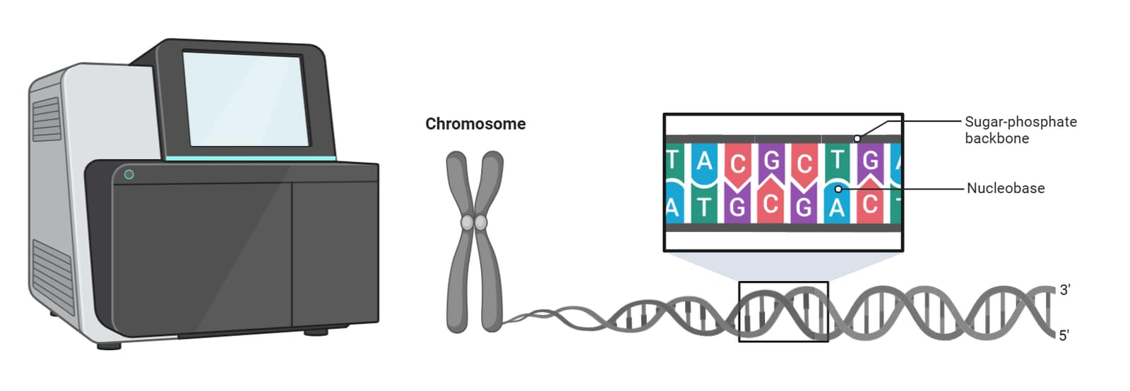

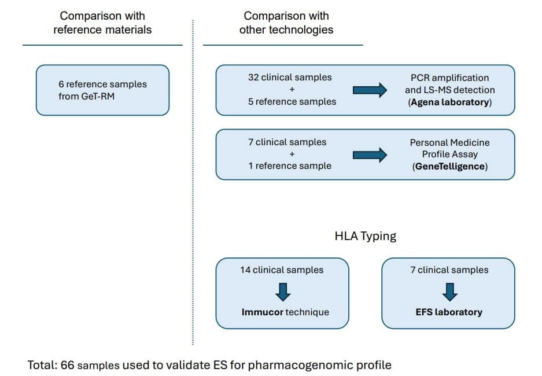
23 pharmacogènes
217 variants
Concordance : 95.4%
Non analysable : 4,1%
Différence : 0.5%
Concordance : 99,7%
Différences : 0,3%
Concordance parfaite concernant le profil de métabolisme
xHLA
*Allele concordance : 100%
Complete pharmacogenomic profile from exome sequencing
Ilias Bensouna, Aleksandra Grujic et al. submitted

Slide 32

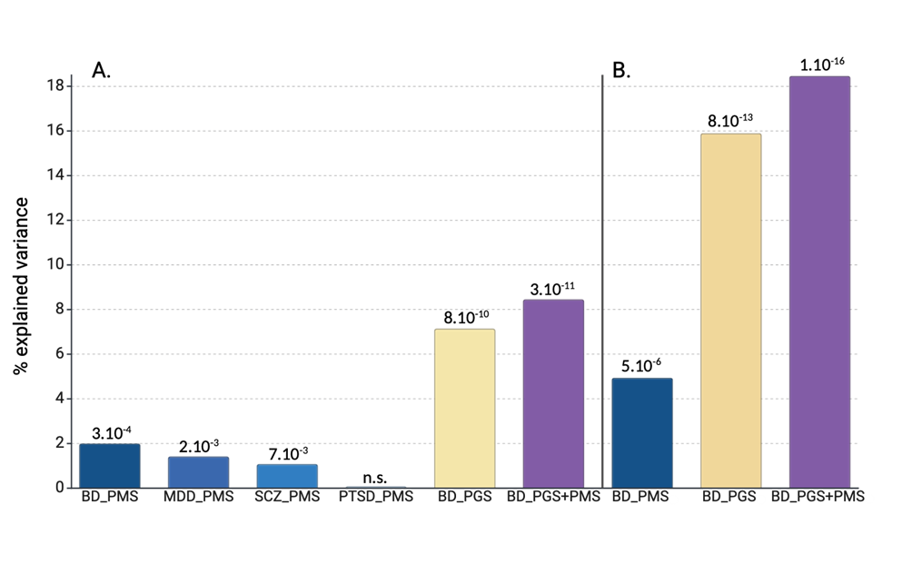
And what about epigenetics?
The association between methylation scores or polygenic scores (x- axis) and bipolar disorder (A), and bipolar I disorder (B) case-control status.
Tesfaye et al EBioMedicine

Slide 33
Epigenetic of Li resistance
Integrative epigenomic analysis identifies convergent pathways of lithium response in bipolar disorder
Spano,L and al (2026) – currently being submitted
Design of the study
459 DNA from blood
6 DNA from iPSC
DNA Methylation analysis (Illumina EPICv2 methylation array)
DMR
DNA Methylation analysis (WGBS)
DMR
RNA-seq
DEG
Comparison : 167 LiR vs 292 LiNR
Comparison : 3 LiR vs 3 LiNR

Slide 34
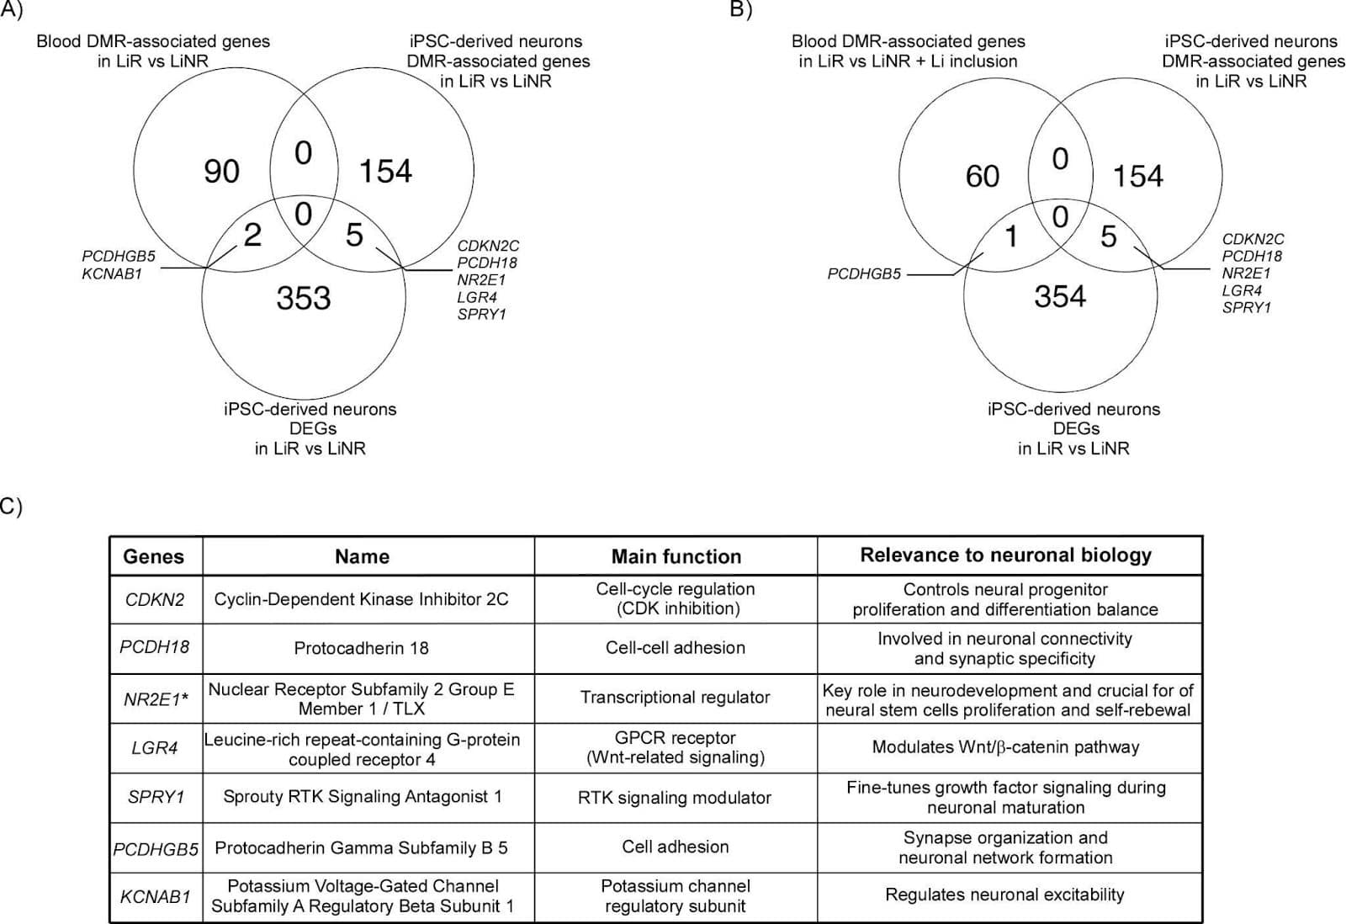
Epigenetic of Li resistance
Overlapping genes analysis between DMRs from Blood, DMRs
and DEGs from iPSC-derived neurons
Spano,L and al (2026) – currently being submitted

Slide 35

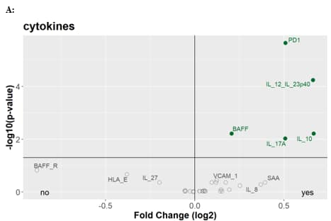
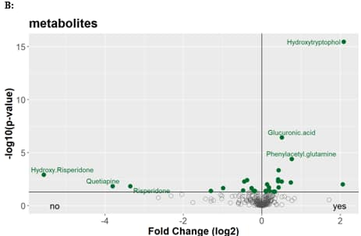
And what about metabolomics?
FACE-SCZ : 318 individuals with SZ including 62 (20%) resistant to antipsychotics and treated with clozapine
Volcano plot of Cytokines (A) and metabolites after removing the 3 Clozapine related compounds (B) comparing Resistant and non-resistant schizophrenia patients. Molecules with an adjusted p-value below 5% are shown in green.
Frajerman et al - submitted

Slide 36
Conclusion

Slide 37
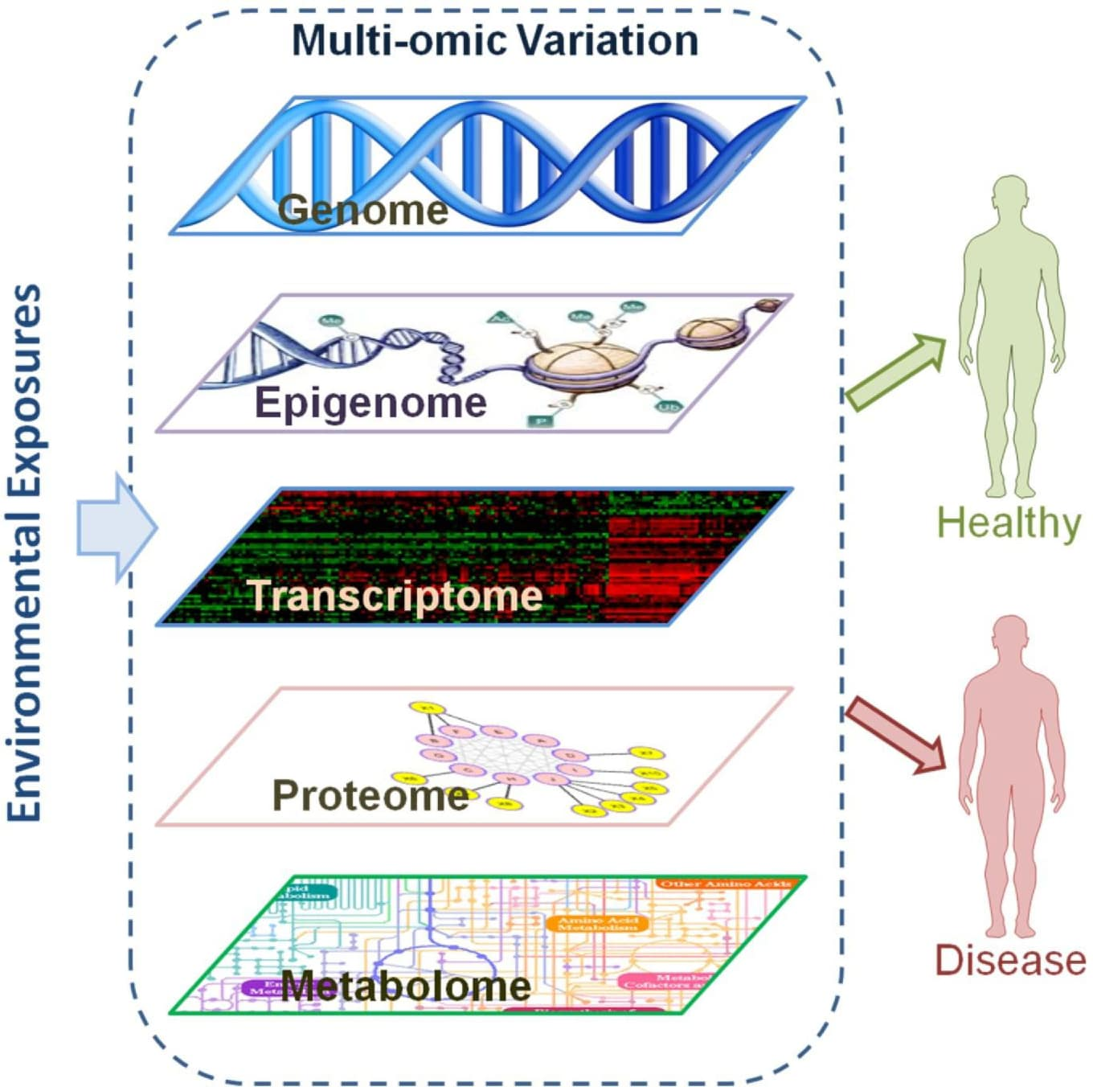
Shorten the therapeutic journey
Decrease the exposure to side-effects
Responders
Better understanding of pathophysiology and development of novel drugs
Close monitoring
Intensification of therapeutic strategies
(eg. psychosocial interventions)
Non responders

