Slide 1
Protocole Cohorte French Minds
Cohorte française longitudinale et multimodale de patients atteints de troubles majeurs de l’humeur, de troubles psychotiques, de troubles du spectre de l’autisme et de témoins
Ophélia Godin, Chercheuse CR
Inserm U955, IMRB, Equipe Psychiatrie Translationnelle, Fondation FondaMental
ophelia.godin@inserm.fr

Slide 2


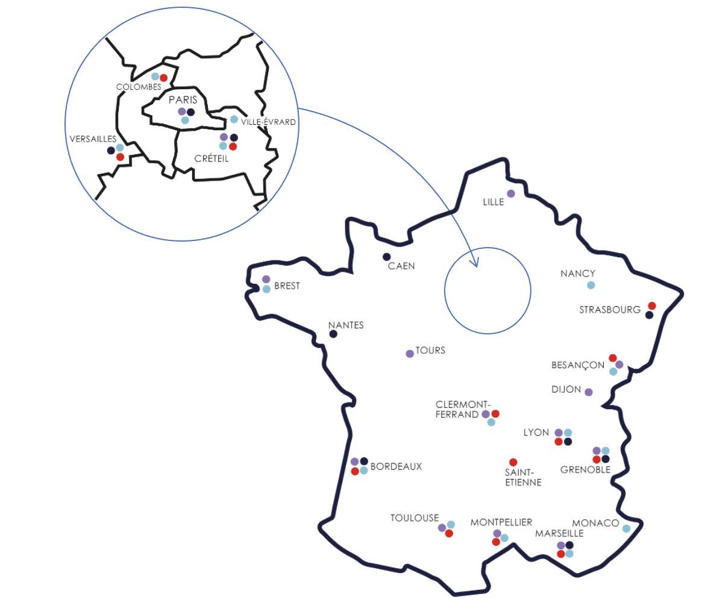

French Minds Cohort
French Minds: Cohorte nationale, multimodale et longitudinale de 2500 personnes vivants avec un trouble psychiatrique et 500 témoins
Etude multicentrique
33 centres en France métropolitaine -
Réseau national de centres experts pour les maladies mentales (Centres experts FondaMental – Centre Premiers épisodes psychotiques)
En moyenne:
~75 patients/centre
+ 4 CIC coordinateurs pour les témoins: Créteil, Besançon, Lille, Tours
RIPH 1
Catégorie 1 de la loi Jardé en raison du nombre d'interventions réalisées spécifiquement pour la recherche
Etude prospective sur 5 ans
Période d’inclusion de 42 mois
Période de suivi de 18 mois

Slide 3
French Minds Cohort
To identify trans or a-nosographic dimensions/ homogeneous clinical forms
EXISTING CATEGORICAL
DIAGNOSTIC ENTITIES
QUANTITATIVE TRANSNOSOGRAPHIC DIMENSIONS
HOMOGENEOUS
CLINICAL SUBGROUPS
Homogeneous subgroups
Clinically and biologically defined
and which can be treated
with mechanisms-based treatments
Bipolar
disorders
Neuro-
developpement
ASD
Recurrent
Depression
PEP
Schizophrenia
Séverité
Métabolisme
Sommeil
Integration of clinical, cognitive, digital and biological data
to identify transnosographic and multimodal dimensions such as
anhedonia/social withdrawal/neurodevelopmental burden/...
which may be the target of specific treatments

Slide 4
Transnosographic dimensions / clinical forms
6 criteria for choosing dimensions
Prioritized dimensions
Anhedonia
1. Transnosographic: present in different diagnostic categories
Abnormal sensory processing
2. Underpinned by specific biological hypotheses
Neurodevelopmental burden
3. Measurable in humans and animals: existing translational models
Cognitive flexibility
Impulsiveness / suicidal ideation
4. Existing therapeutic target
Social withdrawal / negative symptoms
5. Replicability possible on other International cohorts
Sleep disorders
Severity
6. Recognized by patients as causing a disability
Immuno-metabolic dysregulation

Slide 5
French Minds Cohort
Individuals included: 2500 patients with psychiatric disorders and 500 controls
Age of participants = 15 - to 60 years old
Duration of recruitment : 4 years
Duration of study for 1 participant : 18-month max
Total duration of the study : 5 years
DSM-5 Pathologies | Patients to be recruited N
First episode psychotic (FEP) | 400
Schizophrenia | 600
Bipolar disorders | 750
Recurrent/resistant depressive episode | 400
Autism without intellectual deficiency | 350
Total number of patients | 2500
Inclusion Criteria
Being evaluated in Expert Center
With a confirmed diagnosis of one of the psychiatric disorders listed
Being compatible with clinical, biological, and medical imaging examinations
Being affiliated with, or a beneficiary of, social security
No pregnancy
Agreeing to be informed if any abnormality is detected during the MRI

Slide 6
Common denominator post expert center
Interview SCID/DSM4-5 for the main psychiatric disorders / ADI-ADOS for TSA
Depressive symptoms : MADRS (BD & DR & PEP)
Manic symptoms : YMRS (BD, DR, SZ, PEP)
Psychotic symptoms : PANSS (SZ, PEP)
Childhood trauma: CTQ
Tobacco: Fagerstrom
Suicidal attempt/ideation : ISF (except for ASD : question suicidal behavior)
Functioning : GAF (Global Assessment Functioning)
Quality of life: EQ5D
Medical and family history
Physical comorbidities (neurological, cardiovascular, inflammatory, dermatological…)
Physical examination (BMI, waist circumference, Blood pressure)
Sleep disorders: PSQI (except for ASD : 2 questions Hypersomnia / Insomnia)
CGI
Treatments : somatic + psychotropic (onset date, end)
History of addiction
Socio-demography :
      Sex at birth, date of birth, education level, CSP/work
Data already collected in FACE/Centre

Slide 7
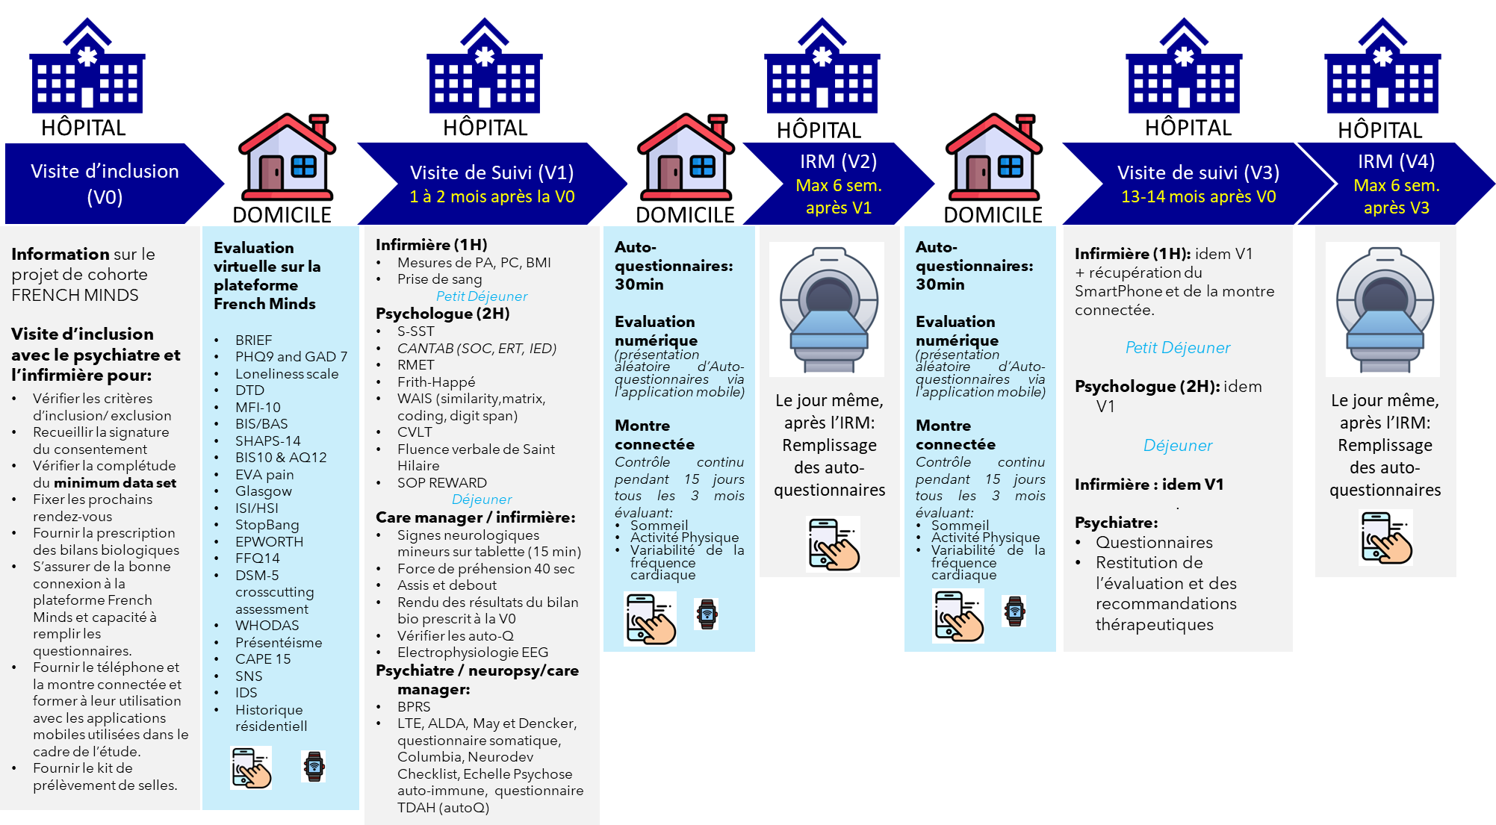
French Minds Cohort

Slide 8




French Minds Cohort
HÔPITAL
HÔPITAL
HÔPITAL
HÔPITAL
Visite de Suivi (V1)
1 à 2 mois après la V0
IRM (V2)
Max 6 sem. après V1
Visite de suivi (V3)
13-14 mois après V0
IRM (V4)
Max 6 sem. après V3
DOMICILE
DOMICILE
Evaluation virtuelle sur la plateforme French Minds
BRIEF
PHQ9 / GAD 7
Loneliness scale
DTD
MFI-10
BIS/BAS
SHAPS-14
BIS10 & AQ12
EVA pain
Glasgow
ISI/HSI
StopBang
EPWORTH
FFQ14
DSM-5 crosscutting
WHODAS
TDAH
Présentéisme
CAPE 15
SNS
IDS
Historique résidentiel
Infirmière (1H)
Mesures des constantes
Prise de sang
Petit Déjeuner
Psychologue (2H)
S-SST
CANTAB (SOC, ERT, IED)
RMET
Frith-Happé
WAIS (similarity,matrix, coding, digit span)
CVLT
Fluence verbale de Saint Hilaire
SOP REWARD
Déjeuner
Care manager / infirmière:
Signes neurologiques mineurs sur tablette (15 min)
Test force de préhension
Test « assis et debout »
Rendu des résultats du bilan bio prescrit à la V0
Vérifier les auto-Q
Psychiatre / neuropsy/care manager:
BPRS, LTE, ALDA, May et Dencker, questionnaire somatique, Columbia, Neurodev Checklist, Echelle Psychose auto-immune
La veille + le jour même de l’IRM:
Remplissage des auto-questionnaires
Evaluation virtuelle sur la plateforme French Minds
BRIEF
PHQ9 / GAD 7
Loneliness scale
DTD
MFI-10
BIS/BAS
SHAPS-14
BIS10 & AQ12
EVA pain
Glasgow
ISI/HSI
StopBang
EPWORTH
FFQ14
DSM-5 crosscutting
WHODAS
TDAH
Présentéisme
CAPE 15
SNS
IDS
Historique résidentiel
Infirmière (1H): idem V1
+ récupération du SmartPhone et de la montre connectée.
Petit Déjeuner
Psychologue (2H): idem V1
Déjeuner
Infirmière : idem V1
.
Psychiatre / neuropsy / care manager: idem V1 +
Questionnaires
Restitution de l’évaluation et des recommandations thérapeutiques
La veille + le jour même de l’IRM:
Remplissage des auto-questionnaires
DOMICILE

Slide 9



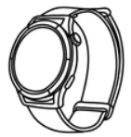



Clinical evaluation
To identify trans or a-nosographic dimensions/ homogeneous clinical forms
Physical examination
Somatic & psychiatric medication
Physical measurement: Weight, Height, BMI, waist
Circumference, head circumference
Blood pressure
Muscle strength : Handgrip, Sit-to-Stand
Blood sample (routine and research)
  Medication: duration, dose…
  Response to treatment : ALDA, May & Denker
Demographic data
Gender, age, professional activity, education level,
residential history
  Psychiatric diagnosis (DSM-V/SCID)
  Lifetime characterization (nb episode, age of onset, hospitalization….)
  Psychiatric comorbidities (Anxiety, Addictions…)
  Current symptomatology (BPRS, IDS30, PHQ9…)
  Suicidal ideation (C-SSR)
  Global functioning (Whodas…)
  Quality of life (EQ5D)
  Addiction
Environnemental data
Childhood trauma (CTQ)
Stressful life event (LTE)
Lifestyle factors (Diet, physical activity)
Smoking habits
Cannabis consumption
Sleep
+ smartwatch
+ pollution (for a subset of the sample)

Slide 10
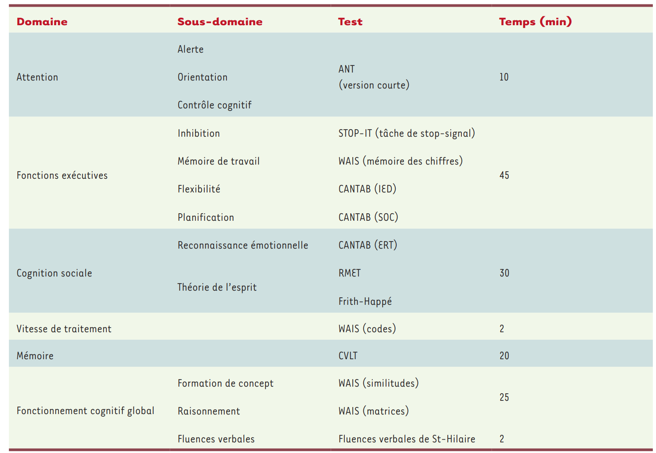

Clinical evaluation
Neuropsychological data
Attention
Executive function
Global cognitive functioning
Verbal Fluency
Memory
Processing speed
Social cognition
Physical comorbidities
Medical conditions: Cardiovascular, neurological,
Endocrine & metabolic disorders, dermatological,
auto-immune, Liver and gastrointestinal disorders…
Minor Neurological sign
Family history: psychiatric and medical
Chainage Données SNDS

Slide 11
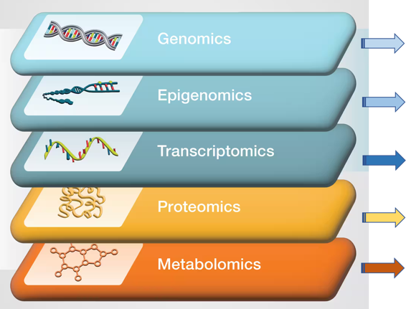
Integratives multi-omics analyses
Génotypage (ImmunoChip et GSA)
Séquençage du génome entier 30X
Méthylation de l’ADN (EPIC v2)
Séquençage de l’ARN
Bilan spécifique (cytokines, auto-anticorps, stress oxydatif, marqueurs barrières, cellules immunitaires...)
Spectrométrie de masse (métabolites, lipides)
Niveaux de cortisol diurne
Matériel biologique stocké pour analyses futures (PBMC pour culture cellulaire, microRNA...)

Slide 12



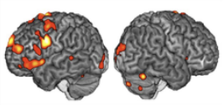
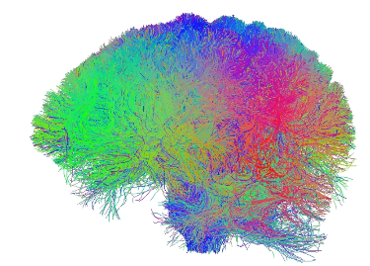
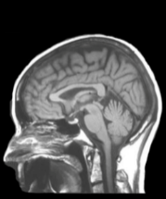

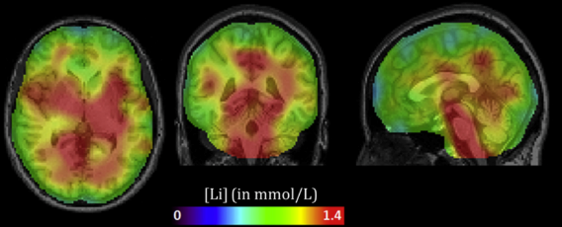
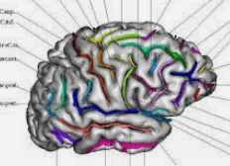
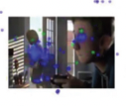
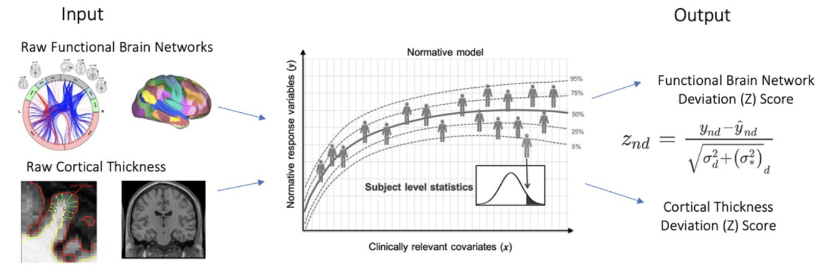
Brain imaging
Coordonnated by Charles Laidi et Marie Chupin, CEA
Anatomical Imaging
functional MRI
Watching a film
Measurement of eye movement
functional MRI
Performing an MRI task
diffusion MRI
Tractography
Lithium 7 IRM
MRI Spectroscopy
3 Tesla sequences (1h)
at all imaging inclusion sites
7 advanced Tesla sequences (1h)
In Paris, Marseille, Lille and Lyon
Van der Meer et al. 2022
Frey et al. 2021
Normative modelling

Slide 13

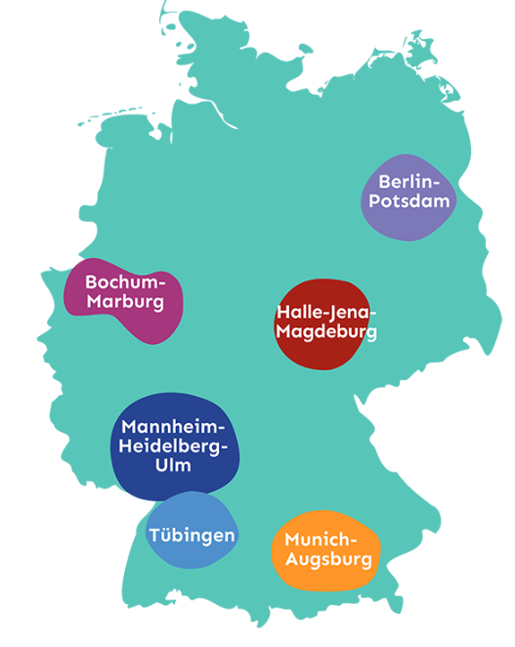
Common data elements
DZPG Common data elements
DSM5 Crosscutting assessment
WHODAS 2.0
PHQ4/9
GAD7
PANAS
CGI
EQ5D

Slide 14
Focus on self-questionnaire
Behavioural Inhibition System – Behavioural Activation System (BIS/BAS): Motivation
Snaith- Hamilton Pleasure Scale (SHAPS): Anhedonia
IDS-SR30: depressive symptoms
Barratt Impulsiveness Scale (BIS10)/Agression Questionnaire (AQ12) : Impulsivity/ Irritability
PPP VAS: Intensity of physical and psychological pain and suicidal ideation
Glasgow scale: sensori-motrice evaluation
CAPE15: Delusional ideas
ISI/HSI : Insomnia/Hypersomnia
ESS (Epworth): sleepiness scale
STOP-BANG: Sleep apnea
DTD: Neurodevelopmental disorders
UCLA Loneliness scale : social withdrawn
Self evaluation of Negative Symptoms (SNS): Negative symptoms
Behavior Rating Inventory of Executive Function (BRIEF): Executive functions
Multidimensional Fatigue Inventory (MFI-10) : Fatigue scale
FFQ14: Food questionnaire
Presenteeism scale: presenteeism at work
Adult ADHD Self-Report Scale : ADHD

Slide 15
Focus on self-questionnaire
Behavioural Inhibition System – Behavioural Activation System (BIS/BAS): Motivation
Snaith- Hamilton Pleasure Scale (SHAPS): Anhedonia
IDS-SR30: depressive symptoms
Barratt Impulsiveness Scale (BIS10)/Agression Questionnaire (AQ12) : Impulsivity/ Irritability
PPP VAS: Intensity of physical and psychological pain and suicidal ideation
Glasgow scale: sensori-motrice evaluation
CAPE15: Delusional ideas
ISI/HSI : Insomnia/Hypersomnia
ESS (Epworth): sleepiness scale
STOP-BANG: Sleep apnea
DTD: Neurodevelopmental disorders
UCLA Loneliness scale : social withdrawn
Self evaluation of Negative Symptoms (SNS): Negative symptoms
Behavior Rating Inventory of Executive Function (BRIEF): Executive functions
Multidimensional Fatigue Inventory (MFI-10) Fatigue scale
FFQ14: Food questionnaire
Presenteeism scale : presenteeism at work
Adult ADHD Self-Report Scale : ADHD
Anhedonia

Slide 16
Focus on self-questionnaire
Behavioural Inhibition System – Behavioural Activation System (BIS/BAS): Motivation
Snaith- Hamilton Pleasure Scale (SHAPS): Anhedonia
IDS-SR30: depressive symptoms
Barratt Impulsiveness Scale (BIS10)/Agression Questionnaire (AQ12) : Impulsivity/ Irritability
PPP VAS: Intensity of physical and psychological pain and suicidal ideation
Glasgow scale: sensori-motrice evaluation
CAPE15: Delusional ideas
ISI/HSI : Insomnia/Hypersomnia
ESS (Epworth): sleepiness scale
STOP-BANG: Sleep apnea
DTD: Neurodevelopmental disorders
UCLA Loneliness scale : social withdrawn
Self evaluation of Negative Symptoms (SNS): Negative symptoms
Behavior Rating Inventory of Executive Function (BRIEF): Executive functions
Multidimensional Fatigue Inventory (MFI-10) Fatigue scale
FFQ14: Food questionnaire
Presenteeism scale : presenteeism at work
Adult ADHD Self-Report Scale : ADHD
Impulsivity / suicidal behaviours

Slide 17
Focus on self-questionnaire
Behavioural Inhibition System – Behavioural Activation System (BIS/BAS): Motivation
Snaith- Hamilton Pleasure Scale (SHAPS): Anhedonia
IDS-SR30: depressive symptoms
Barratt Impulsiveness Scale (BIS10)/Agression Questionnaire (AQ12) : Impulsivity/ Irritability
PPP VAS: Intensity of physical and psychological pain and suicidal ideation
Glasgow scale: sensori-motrice evaluation
CAPE15: Delusional ideas
ISI/HSI : Insomnia/Hypersomnia
ESS (Epworth): sleepiness scale
STOP-BANG: Sleep apnea
DTD: Neurodevelopmental disorders
UCLA Loneliness scale : social withdrawn
Self evaluation of Negative Symptoms (SNS): Negative symptoms
Behavior Rating Inventory of Executive Function (BRIEF): Executive functions
Multidimensional Fatigue Inventory (MFI-10) Fatigue scale
FFQ14: Food questionnaire
Presenteeism scale : presenteeism at work
Adult ADHD Self-Report Scale : ADHD
Abnormal sensory processing

Slide 18
Focus on self-questionnaire
Behavioural Inhibition System – Behavioural Activation System (BIS/BAS): Motivation
Snaith- Hamilton Pleasure Scale (SHAPS): Anhedonia
IDS-SR30: depressive symptoms
Barratt Impulsiveness Scale (BIS10)/Agression Questionnaire (AQ12) : Impulsivity/ Irritability
PPP VAS: Intensity of physical and psychological pain and suicidal ideation
Glasgow scale: sensori-motrice evaluation
CAPE15: Delusional ideas
ISI/HSI : Insomnia/Hypersomnia
ESS (Epworth): sleepiness scale
STOP-BANG: Sleep apnea
DTD: Neurodevelopmental disorders
UCLA Loneliness scale : social withdrawn
Self evaluation of Negative Symptoms (SNS): Negative symptoms
Behavior Rating Inventory of Executive Function (BRIEF): Executive functions
Multidimensional Fatigue Inventory (MFI-10): Fatigue scale
FFQ14: Food questionnaire
Presenteeism scale : presenteeism at work
Adult ADHD Self-Report Scale : ADHD
Sleep disorders

Slide 19
Focus on self-questionnaire
Behavioural Inhibition System – Behavioural Activation System (BIS/BAS): Motivation
Snaith- Hamilton Pleasure Scale (SHAPS): Anhedonia
IDS-SR30: depressive symptoms
Barratt Impulsiveness Scale (BIS10)/Agression Questionnaire (AQ12) : Impulsivity/ Irritability
PPP VAS: Intensity of physical and psychological pain and suicidal ideation
Echelle de Glasgow: sensori-motrice evaluation
CAPE15: Delusional ideas
ISI/HSI : Insomnia/Hypersomnia
ESS (Epworth): sleepiness scale
STOP-BANG: Sleep apnea
DTD: Neurodevelopmental disorders
UCLA Loneliness scale : social withdrawn
Self evaluation of Negative Symptoms (SNS): Negative symptoms
Behavior Rating Inventory of Executive Function (BRIEF : Executive functions
Multidimensional Fatigue Inventory (MFI-10) Fatigue scale
FFQ14: Food questionnaire
Présenteisme scale: presenteeism at work
Adult ADHD Self-Report Scale : ADHD
Neurodevelopmental

Slide 20
Focus on self-questionnaire
Behavioural Inhibition System – Behavioural Activation System (BIS/BAS): Motivation
Snaith- Hamilton Pleasure Scale (SHAPS): Anhedonia
IDS-SR30: depressive symptoms
Barratt Impulsiveness Scale (BIS10)/Agression Questionnaire (AQ12) : Impulsivity/ Irritability
PPP VAS: Intensity of physical and psychological pain and suicidal ideation
Glasgow scale: sensori-motrice evaluation
CAPE15: Delusional ideas
ISI/HSI : Insomnia/Hypersomnia
ESS (Epworth): sleepiness scale
STOP-BANG: Sleep apnea
DTD: Neurodevelopmental disorders
UCLA Loneliness scale : social withdrawn
Self evaluation of Negative Symptoms (SNS): Negative symptoms
Behavior Rating Inventory of Executive Function (BRIEF) : Executive functions
Multidimensional Fatigue Inventory (MFI-10) Fatigue scale
FFQ14: Food questionnaire
Presenteeism scale : presenteeism at work
Adult ADHD Self-Report Scale : ADHD
Social withdrawn / negative symptoms

Slide 21
Focus on self-questionnaire
Behavioural Inhibition System – Behavioural Activation System (BIS/BAS): Motivation
Snaith- Hamilton Pleasure Scale (SHAPS): Anhedonia
IDS-SR30: depressive symptoms
Barratt Impulsiveness Scale (BIS10)/Agression Questionnaire (AQ12) : Impulsivity/ Irritability
PPP VAS: Intensity of physical and psychological pain and suicidal ideation
Glasgow scale: sensori-motrice evaluation
CAPE15: Delusional ideas
ISI/HSI : Insomnia/Hypersomnia
ESS (Epworth): sleepiness scale
STOP-BANG: Sleep apnea
DTD: Neurodevelopmental disorders
UCLA Loneliness scale : social withdrawn
Self evaluation of Negative Symptoms (SNS): Negative symptoms
Behavior Rating Inventory of Executive Function (BRIEF): Executive functions
Multidimensional Fatigue Inventory (MFI-10) Fatigue scale
FFQ14: Food questionnaire
Presenteeism scale : presenteeism at work
Adult ADHD Self-Report Scale : ADHD
Cognitive flexibility

Slide 22




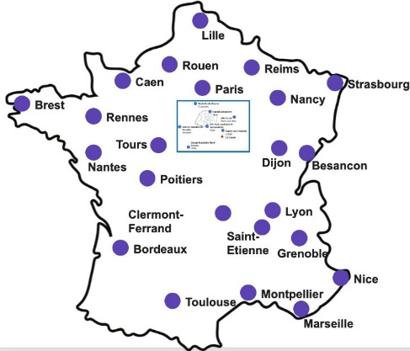





WP1: Mise en place de la Cohorte French Minds
Coordination: groupe des French Minders
33 Centres French Minds – 10 MEP faite et 10 programmées
Recrutement équipe dédiée Psychologue, Infirmière, TEC par centre French Mind
CPP : Avis Favorable Septembre 2024
ANSM : Autorisation Juillet 2024
Février - Juin 2025 : Signature des conventions hospitalières et accords de collaboration.
Rédaction: Conventions, protocole, consentement patient etc
Données pré-existantes, ouvertes pour collaboration : 9000 Patients cohorte FACE
Dont 3000 patients sont en cours de génotypages au CNRGH (début 2026)
E-CRF (prestataire) + Plateforme French Minds (2025)
Tablette+ SmartPhone+ Montre connectée
Guides, procédures, manuels, check list
Recrutement personnel depuis Automne 2025
Formation des personnels débutée Janvier 2026
1er patient inclu prévu en Avril 2026
Durée de l’étude/patient: 18 mois max
Durée totale de l’étude: 5 ans
22

Slide 23
Retrouvez toutes nos actualités

