Slide 1
Immuno-metabolic psychiatry
Ophélia Godin, Aiste Lengvenyte, Ariel Frajerman, Jeremy Bernard, Wahid Boukouaci, Jan Erkilic, Bruno Etain, Ana Andreazza, Marion Leboyer
ophelia.godin@inserm.fr
Inserm U955, IMRB U955 Translational Neuropsychiatry
Fondation FondaMental

Slide 2
Définition du syndrome métabolique

Slide 3
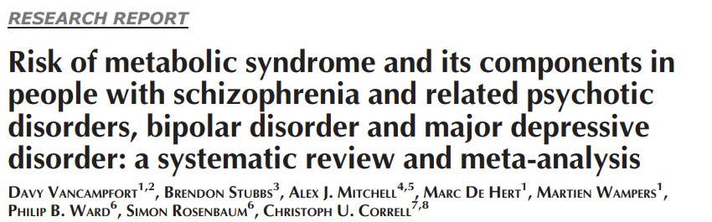
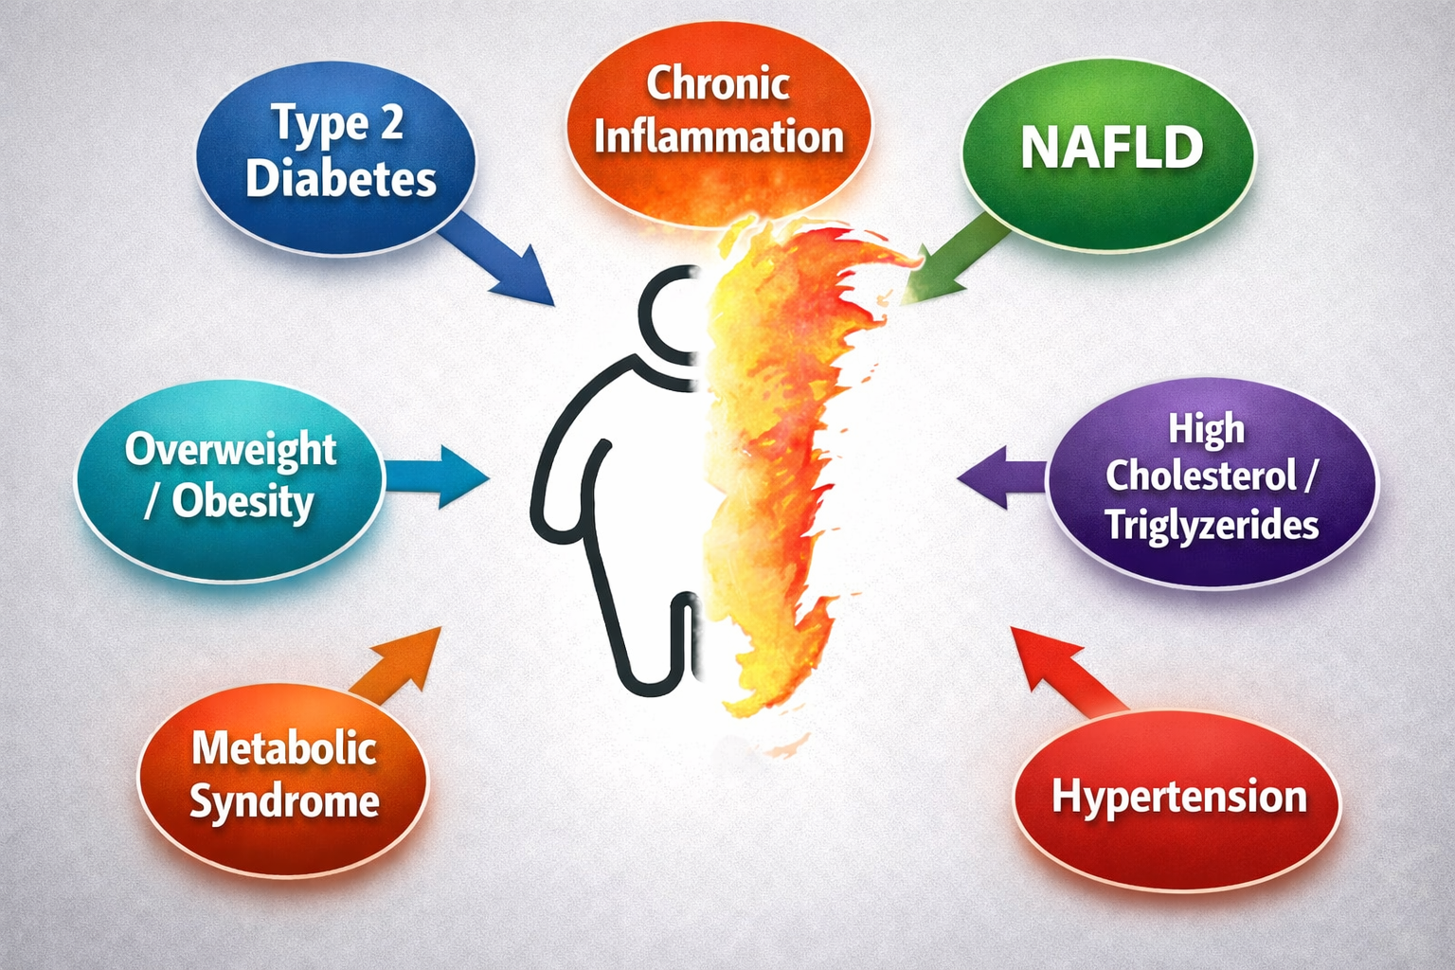
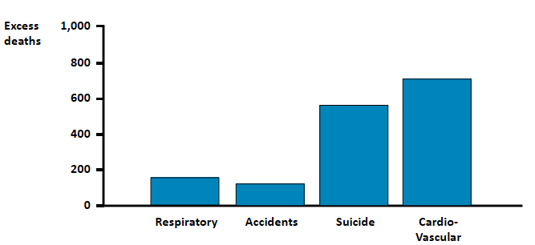



Scientific context
Weiner et al., 2011
Transdiagnostic clinical form : High frequency in all psychiatric illness
Prevalence : 30 - 40%: Risk x 2 / pop without mental illness
Contributes to a 10–15 year reduction in life expectancy in people with psychiatric disorders & 1st cause of death
Multiple biological pathway involved: immuno-inflammatory dysregulation, alteration in the kynurenin pathway, mitochondrial dysfunction, oxidative stress, HPA axis dysregulation….

Slide 4
2. Résultats préliminaires

Slide 5





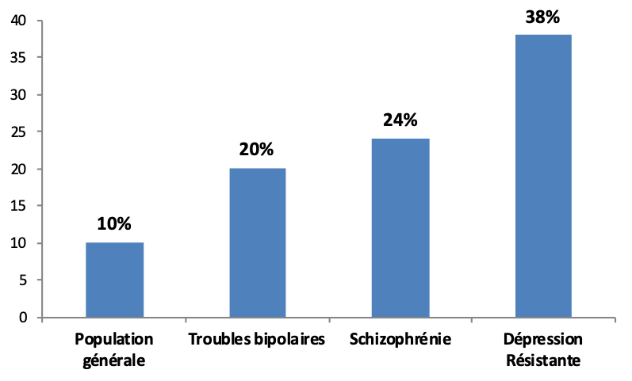


What we have done so far
Facteurs associés et conséquences des maladies somatiques
Sleep
Circadian rythms
Godin O et al. 2022
Sunhary de Verville et al. 2022
Nobile B et al. 2023
Zachos K et al. 2024
Godin et al. 2022
Godin et al. 2017
Lifestyle & addiction (diet, physicial activity, tobacco)
Metabolic abnormalities
(MetS /NAFLD)
Seasonal pattern
Global functioning
Cognitive disorders
Relapse/hospitalisations
Treatment resistance
Goeffroy PA et al. 2022
Environmental factors (childhood trauma)
Godin O et al. 2021
Fond G et al. 2018
Godin O et al. 2018, 2020
Palimaru et al. 2025
Saitoh et al. 2025
Godin O et al. 2014,2015, 2020, 2021
Tokarski et al. 2025
Biological pathways: Inflammation /mitochondria
Side effect to treatment (SGA, Antidepressant, hypnotic)
Foiselle M et al. 2021
Godin O et al. 2022
Godin O et al. 2017
Zachos K et al. 2024

Slide 6

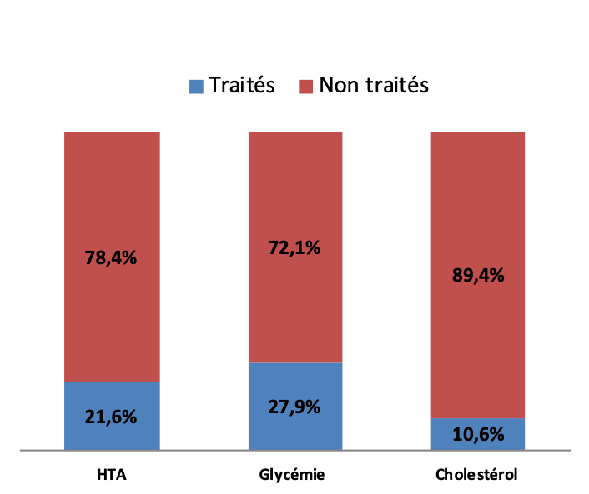
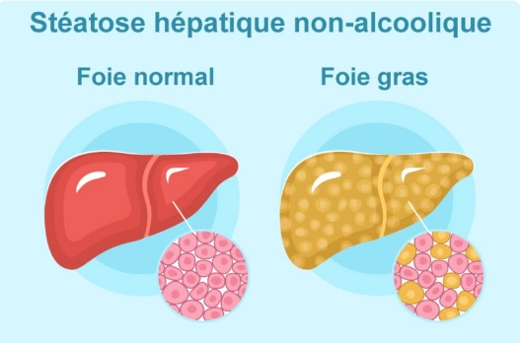
Transdiagnostic clinical form in patients with psychiatric disorders in France
Cohortes FondaMental Advanced Center of Expertise (FACE)
Metabolic syndrome
Obesity
HTA
Lipidic abnormalities
Abnormal glycemia
Prevalence 2 x higher compared to general population
Not treated
Godin O et al. J Clin Psy. 2014, 2020
Godin O et al. Schizophr Res. 2015
Godin O et al. Acta Psy Scan. 2021
Tokarski et al. J Psychosom Res 2025

Slide 7

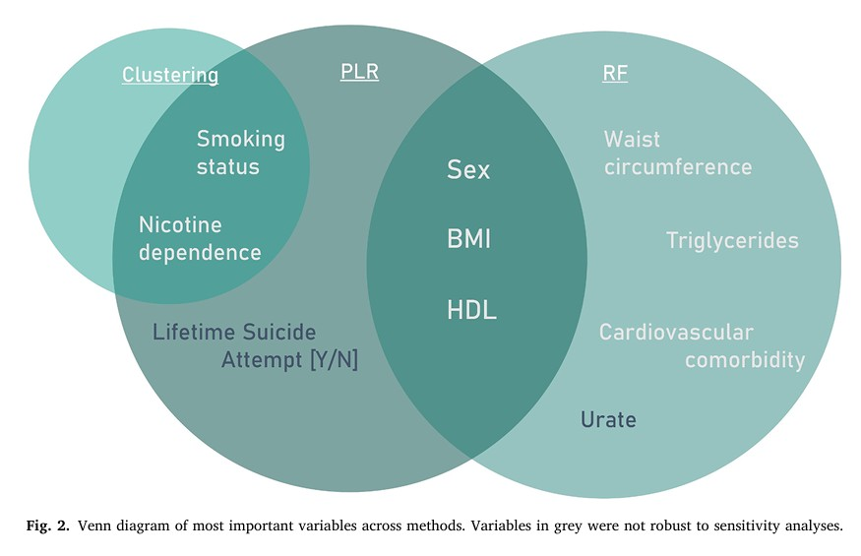
Chronic low grade inflammation in psychiatric population
Transdiagnostic analysis FACE Cohorts: n = 7149 patients: 4797 bipolar disorder, 1958 schizophrenia
and 394 resistant major depression
Diagnostic cohorts were equally represented across CRP groups
Mostly related with female gender, BMI, waist circumference, low HDL cholesterol and elevated triglycerides + tobacco
Rietberg T et al. Brain, Behavior, and Immunity 134 (2026) 106464

Slide 8
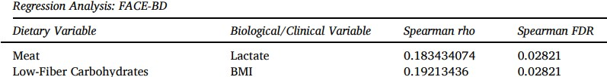
Risk factors associated with metabolic syndrome
Sleep, circadian rythms
Diet
Sleep disorders are associated with higher waist circumference (OR=1.9, 95%CI= 1.0–3.4)
Individuals with evening chronotype had higher level of triglycerides
Association between evening chronotype and cardiovascular indice (atherogenic index of plasma) (OR = 4.8, 95%CI = 1.6–14.7).
Lower Consumption of High fiber Carbohydrates in MetS +
Association between higher meat consumption and higher lactates levels
Association between increased Low-fiber carbohydrate consumption and higher BMI
Godin O, Etain B et al., Chronobiology International, 2017
Zachos K et al., Bipolar disorders, 2024
Notes:
Glucide riche en fibres

Slide 9
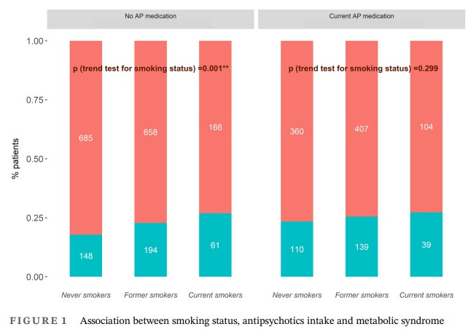
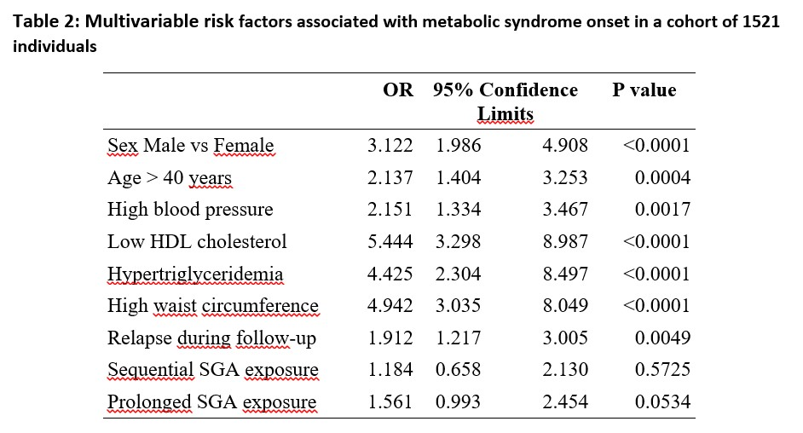

Risk factors associated with metabolic syndrome
Psychotropic treatment
Tobacco
In a cohort of BD patients without MetS at baseline, 293/1521 (19%) develop MetS during follow-up
Association between tobacco & metabolic syndrome mediated by antipsychotics
Nobile B et al., Acta Psychiatr Scand. 2023 Apr;147(4):373-388.
Godin O et al. Acta Psychiatr Scand. 2024 Mar;149(3):207-218

Slide 10


Environnemental factors
Relation between childhood trauma and somatic comorbidities
  1506 individuals with BP, 53% with at least 2 somatic comorbidities
  Association with metabolic syndrome
Association ++ between somatic comorbidities & childhood trauma
Sexual abuse mainly
Godin O et al., Psychol Med 2023;53(15):7341-7349
Godin O et al., Psychoneuroendocrinology. 2021;131:10532
 | Childhood Trauma
 | 1st tertile (N= 501, 33.65%) | 2nd tertile (N= 517, 34.72%) | 3rd tertile (N= 471, 31.63%) | Univariate p-value | Multivariate p-value
Parameters, mean (SD)
Body Mass Index | 26.27 (5.21) | 25.87 (5.32) | 26.81 (5.72) | 0.018* | 0.020*
Waist circumference | 95.20 (14.72) | 94.26 (14.51) | 96.45 (15.79) | 0.168 | 0.009*
Metabolic syndrome, n (%)
No | 248 (32.33%) | 294 (38.33%) | 225 (29.34%) | 0.043* | 0.072
Yes | 102 (30.91%) | 107 (32.42%) | 121 (36.67%)
Essou A et al. 2025 submitted

Slide 11


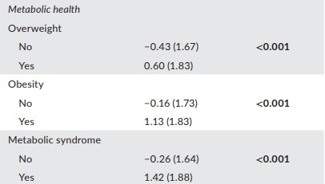
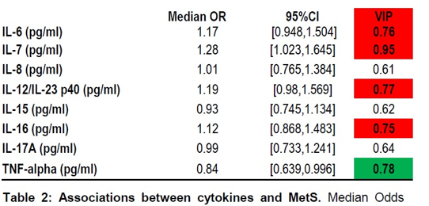
Biological mechanisms/pathway
Facteurs associés et conséquences des maladies somatiques
MetS & inflammation
MetS & premature aging
Biological Age = Combinaison biological factors and/or physical measures collected by routine (age, albumin, creatinin, CRP, alkaline phosphatase, HbA1c, SBP and total cholesterol)
15% of BD individuals : Biological Age > 2 years / chronological age
Positive values indicate that an individual is biologically older than their chronological age
Individuals with MetS + had premature aging
Foiselle et al., BBI health 2022; Mar 29;22:100436
Etain et al., Bipolar Disorders 2024; 26:595 - 605

Slide 12



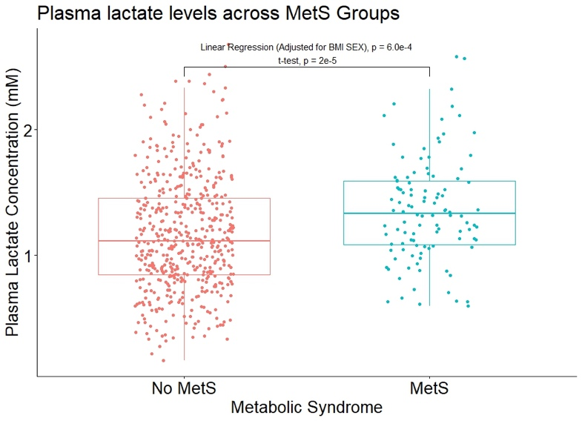
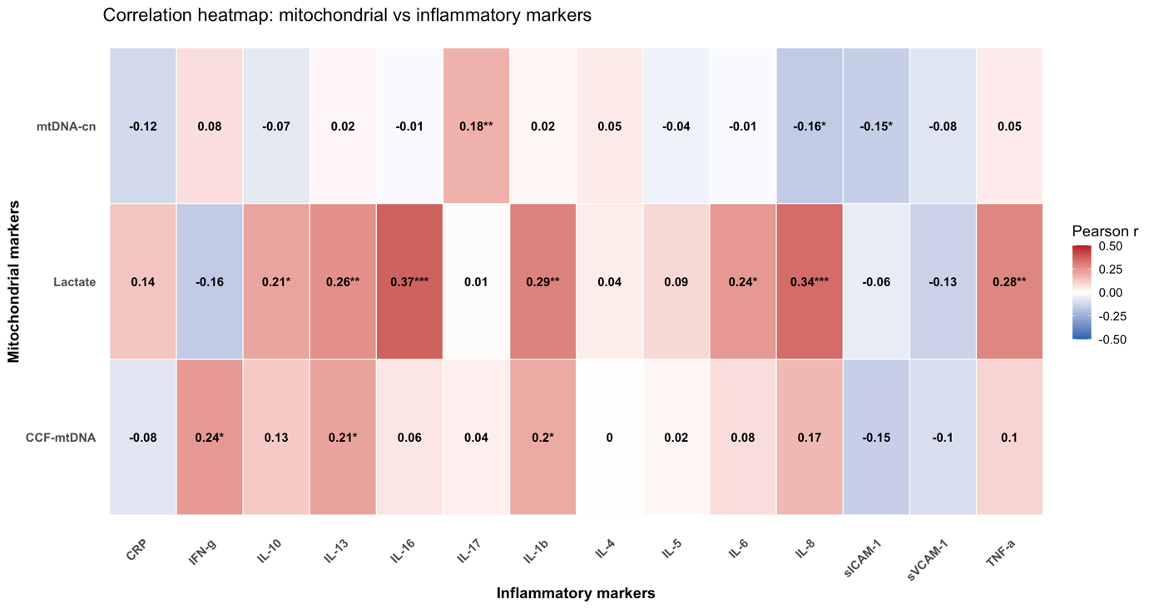
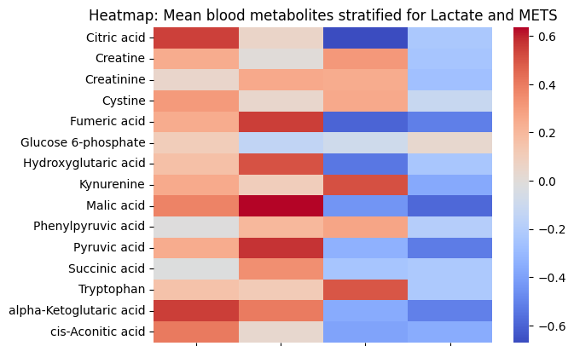
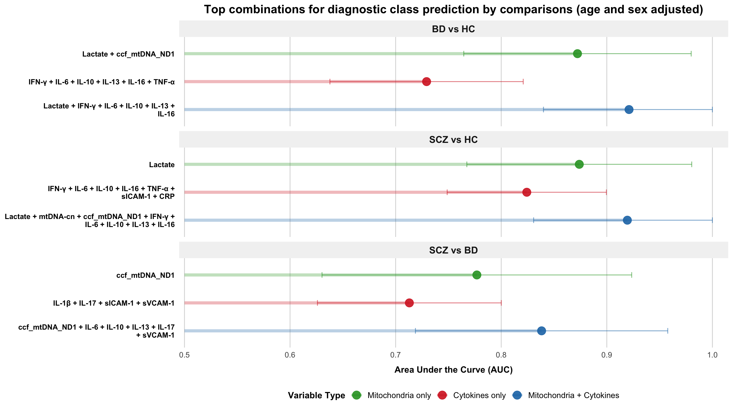
Biological mechanisms/pathway
Facteurs associés et conséquences des maladies somatiques
MetS & mitochondrial biomarkers in BD individuals (837 BD patients FACE-BD)
Mitochondrial dysfunction &
Inflammation (IGIVE cohort)
Higher Lactate is associated with MetS
High lactate
and METS
High lactate
and NO METS
Low lactate
and METS
Low lactate
and NO METS
Different profil of metabolite are identified:
MetS + Lactate + : citric acid & alpha-ketoglutaric acid
MetS + Lactate - : kynurenine & tryptophan
Zachos et al. Psychiatric Research;2024, 339:116063
Bernard et al., in preparation

Slide 13


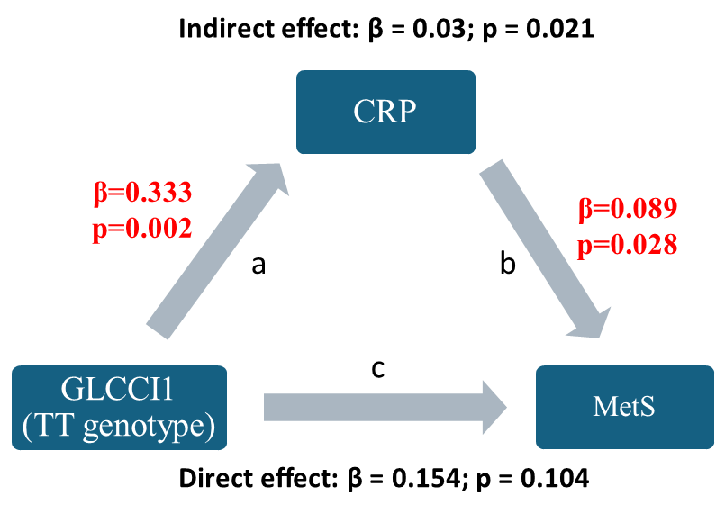
Biological mechanisms/pathway : MetS & HPA dysregulation
Facteurs associés et conséquences des maladies somatiques
Central Nervous System
Stress
GR
GLCCI1
Hypothalamus
Dysregulation
Inflammation
MetS
Corticotropin-Releasing Hormone (CRH)
GR
GLCCI1
Pituitary gland
Adrenocorticotropic Hormone (ACTH)
Adrenal cortex
Cortisol (ACTH)
Target organs
TNFa, IL1B et IL6
Cortisol
Interaction between GLCCI1 polymorphism (rs37972) and inflammation in the risk of MetS in SCZ
GR : Glucocorticoid Receptors
GLCCI1: glucocorticoid induced 1
Saitoh et al. submitted
Notes:
we investigated whether polymorphisms in glucocorticoid-related genes are associated with inflammation and clinical characteristics in SZ patients.
We showed that the TT genotype at rs37972 was significantly associated with increased likelihood of inflammation and MetS compared with TC/CC genotypes (Inflammation [OR: 3.3, 95%CI: 1.44-7.51, p=0.005], MetS [OR: 2.9, 95%CI: 1.20-7.26, p=0.019]). Additionally, the mediation analysis indicated that the effect of TT genotype at rs37972 on MetS was primarily mediated through systemic inflammation

Slide 14

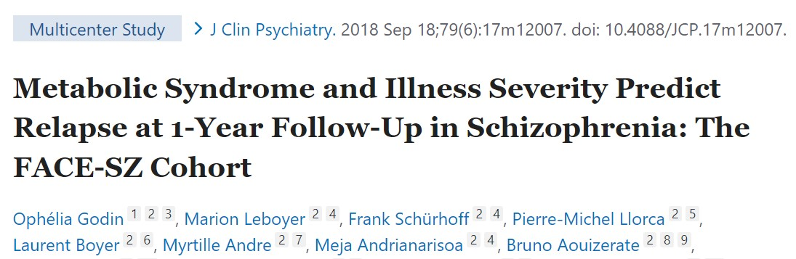
Consequences of Metabolic syndrome
Facteurs associés et conséquences des maladies somatiques
MetS and cognitive deficits
MetS, inflammation & Treatment resistance
Palimaru et al., Acta Psy Scan Nov 2025
MetS & psychotic relapse
OR=3.0 (1.1-8.4) chez les patients SZ avec METS +
Godin et al., 2018, J Clin Psychiatry. 79(6)
Saitoh et al., 2025 Psychiatry Res Aug:350

Slide 15
3. Programme de travail dans le cadre du PEPR PROPSY

Slide 16

WORK PROGRAM in the PEPR PROPSY (2026-2030): analysis of FACE databases
Specific symptoms linked to energy-related : transdiagnostic (BD-MDD-SZ)
  Fatigue
  Weight gain
  Hyperphagia
  Hypersomnia
  Low energy
  Anhedonia
Specific Objectives
  Baseline and longitudinal analysis of immuno-metabolic biomarkers and symptoms across disorders
  Predictive and prognostic examination of these biomarkers
    time-to-relapse, hospitalization, functional decline, treatment resistance
  Identification of a distinct, transnosographic immuno-metabolic subgroup
    clinico-immuno-biological signature
Jan Erkilic PhD (EUR LIVE & ANR PROPSY)
Longitudinal Analysis (Depending of funding):
To study consequences of cardio-metabolic abnormalities on cognitive deterioration in psychiatric disorders
To model longitudinal trajectories from population brain health to early severe mental illness using registry-linked Danish cohorts
Quantify environmental (pollution, infection, stress, trauma) and lifestyle determinants of immuno-metabolic vulnerability
To identify shared biological signatures of energy dysregulation across disorders using multi-omics and AI-based analyses
experimentally validate key mechanisms in rodent models
UK-FR Project (Wakam Award): Collaboration with A. Colasanti (Univ Sussex): UKBB & FACE cohorts
European Project FR-DK-DE-CH-TR: BRAINERGY (Brain Health Initiative)
Hjorthøj et al. Lancet Psychiatry. 2017

Slide 17




WORK PROGRAM in 2026-2030
  Neurobiological projects to understand underlying mechanisms
  Non targeted Metabolomic analysis (RMN) to identify biosignature of cardio-metabolic abnormalities
  (Ariel Frajerman, Fondation Avenir) 🧪
  Association between Accelerated aging (telomere length) and cardiovascular factors / obesity / diabetes
  (Master 2: Eva Gomes, ANR Propsy EDU) ⏳🧬
  Link between hormones and metabolic abnormalities in psychiatric disorders (Master 2: Elise Motsch)
  Collaboration with Ana Andreazza lab (University of Toronto) 🔋
    Analyse of metabolite link to mitochondrial dysfunction on all samples available (BD, SZ)
  Association between white matter hyperintensities (MRI FLAIR/DTI), cardiovascular risk factors and outcomes in mood & psychotic disorders 🧠
    UKBiobank - Collaboration with C Philippe CEA, P Favre, C Laidi (work in progress – research funding)
    APHP Mondor hospital – Collaboration with B. Bapst, Ari Rakatondraibe, P Favre, C Laidi
      3rd year bachelor’s internship (2026) - Mary Virgoulay Lamarre
      Master 2 neuroscience (2027) - Kensa Assali
Hjorthøj et al. Lancet Psychiatry. 2017

Slide 18
WORK PROGRAM in 2026-2030
  Somatic comorbidities: Neurological, Dermatological, Respiratory, Auto-immune, Liver and gastrointestinal disorders, cancer….
  To describe physical comorbidities and their determinants
    Using French Healthcare Insurance data system, hospital database, existing French Cohort (Constance, FACE, cohort of patients), international cohorts
  To estimate clinical and medico-economic impact
    Impact on psychiatric trajectories (hospitalization, quality of life, medical service utilization, resistance to treatment)
    Direct (hospitalizations, medications, consultations) and indirect (work absenteeism, disability, productivity loss) cost (Link to Medico-economic WP4 Isabelle Durand Zaleski)
  Better understand biological mechanism involved
    Identity biomarkers / biological pathway
  Healthcare management
    EU-MIND Initiative (PI: L Boyer, Coralie Grandé): aims to identify key considerations for implementing integrated care models for SMI and physical comorbidities in Europe, based on empirical evidence and expert consensus.
    MediPsy (PI: O Godin, M Salomon (Anticipation Santé), WP4: Public-private partnership)
  Societal impact: Inform patients, healthcare professional (medical intern, psychiatrist, GPs)
Hjorthøj et al. Lancet Psychiatry. 2017

Slide 19


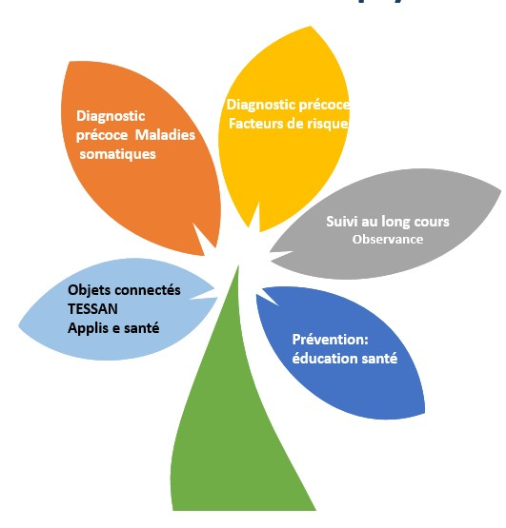

PePR PROPSY (WP4): Public-private partnership
Screening for somatic comorbidities in psychiatry (MediPsy)
Objective: to facilitate access to somatic care in psychiatric facilities
Install a teleconsultation booth with connected objects
Realise a complete somatic check-up with physiological variables
Determine the cardiovascular profile
Provide appropriate & personalized medical recommendations
Feasibility/Acceptability study (protocol under development)
Notes:
Réaliser un bilan somatique complet
Déterminer le profil de risque cardiovasculaire
fournir des recommandations somatiques adaptées et personnalisées

Slide 20
PePR PROPSY (WP4): Public-private partnership
Screening for somatic comorbidities in psychiatry (MediPsy)
Task1: Etablir le cahier des charges fonctionnel et technique
Task2: Créer la cabine de téléconsultation avec les objets connectés nécessaires
Task3: Developper la plateforme digitale avec les algorithmes permettant de dépister les comorbidités physique, de determiner le profile cardiovasculaire et cancer des patients
Task4: Basée sur le profile des patients, propositions de recommendation/propositions pour la prise en charge somatique des patients avec maladies psychiatriques à destinations des cliniciens avec un rapport medical pour le patient et l’ensemble des prof de santé
Task5: Etude de faisabilité / acceptabilité
Hjorthøj et al. Lancet Psychiatry. 2017

Slide 21
Measures in French Minds cohort for immuno-metabolic psychiatry
Extensive physical examination
  Height, weight, BMI
  Blood pressure
  Medical comorbidities
Blood sample
  Lipids (Chol total, HDL, LDL, Triglycerides)
  Glucose profile (glycemia, HbA1c)
  Renal assessment
  Liver check-up (ALP, AST, Bili, GGT)
  HsCRP
  LDL-oxydaze
  Index HOMA-IR
Psychiatric & clinical data
  IDS-SR-30
  SHAPS
  PHQ9
  GAD-7
  Cognitive assessment
  Functioning (Whodas)
  Diet questionnaire (FFQ14)
  Fatigue (Multidimensional Fatigue Inventory)
  Muscular strengh
    up & down 40s
    Handgrip test
Environmental factors: Childhood trauma, lifestyle, drugs, medication, pollution
Multi-omics: Genomics, proteomics, metabolomics…
MRI data: Anatomical, functional, diffusion
Digital assessments: physical activity, sleep, heart rate
Hjorthøj et al. Lancet Psychiatry. 2017

Slide 22
WORK PROGRAM in French Minds 2030 - …….
Transnosographic dimension accross disorders (and compared to controls)
  How to define this sub-group
  Clustering analysis including MetS component and inflammatory markers
Bi-modal analysis
Multimodal signature:
  Clinical
  Imaging
  Digital
  Environmental
  Omics
Trajectories of immuno-metabolic subgroup
Impact of immuno-metabolic features:
  Resistance to treatment
  Cognition
  Functionning
  Suicidal ideation/attempt
Hjorthøj et al. Lancet Psychiatry. 2017

Slide 23
WORK DREAM IN PRECISION PSYCHIATRY
Interventional study : Randomized Control Trial
  Transdiagnostic : Mood disorders and schizophrenia (Basket trial)
  Several pharmacological strategies (Adaptative trial?) in addition to usual treatment (not only Antipsychotic)
    AGPL1 (Tirzépatide? Sémaglutide? )
    Anti-inflammatory drugs
    Lifestyle strategies (Physical activities & healthy diet)
    Ketogenic diet
  Which inclusion criteria for patients ?
      BMI >= 25 kg
      Metabolic syndrome
      CRP > 3
      One of them /a combination of them
Principal Objective: Impact on symptoms (should we focus on energy-related symptoms ?)
Secondary objective : Impact on weight and metabolic parameters
Hjorthøj et al. Lancet Psychiatry. 2017

Slide 24




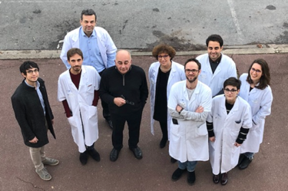




Pr Marion Leboyer
Pr Bruno Etain
Pr Ryad Tamouza
Expert center’s team
Patients & Family
IMRB: Equipe 15 U955 Inserm
Fondation FondaMental
The French Minders…
Thanks !
ophelia.godin@inserm.fr

